Slide 1
Fundamentals of Excel

Slide 2
Trainer Guidelines for Conducting Class
Solve questions live by creating new blank files (Excel, Python, Jupyter notebook, Dashboard) during the session, rather than sharing completed solutions.
Review teaching materials and solutions beforehand, and prepare additional examples to reinforce learning.
Ensure online students can hear you and see the screen clearly at all times.
Test your computer and necessary software before class begins.
Check with online students every 15-20 minutes to see if they understand the material and have any questions.

Slide 3

Excel Roadmap
Advanced Excel
Day 2
Fundamentals of Excel
Day 1

Slide 4
Agenda
Introduction to Excel Interface
Basic Functions (SUM, COUNT, AVERAGE, etc.)
Text Functions and Dates
Lookup and Conditional Functions
Data Cleaning Techniques
Data Visualization with Conditional Formatting
Sorting, Filtering, and Subtotals
Working with Ranges and Tables
Q&A and Practical Exercises

Slide 5

Introduction to Excel Interface

Slide 6
Microsoft Excel Overview
Spreadsheet software for data organization and analysis.
Offers data analysis, visualization, storage, and management.
Importance in Data Analysis
Data preparation and cleaning.
Basic and advanced data analysis.
Data visualization for trends and patterns.
Data sharing in a commonly accepted format.
Importance of Understanding Excel Interface
Efficiency in navigation and task execution.
Improved data access and utilization.
Reduced risk of errors.
Customization for specific needs.

Slide 7
Excel Interface
Excel's user environment for data work.
Key elements include the Ribbon, Tabs, and Quick Access Toolbar
1. The Ribbon
Horizontal strip with tabs and groups of commands.
Tabs like Home, Insert, Page Layout, etc.
2. Quick Access Toolbar
Customizable toolbar for quick access to common commands.
3. Various Views
Normal View: Default for data entry.
Page Layout View: Shows print layout.
Page Break Preview: Reveals print page breaks.

Slide 8
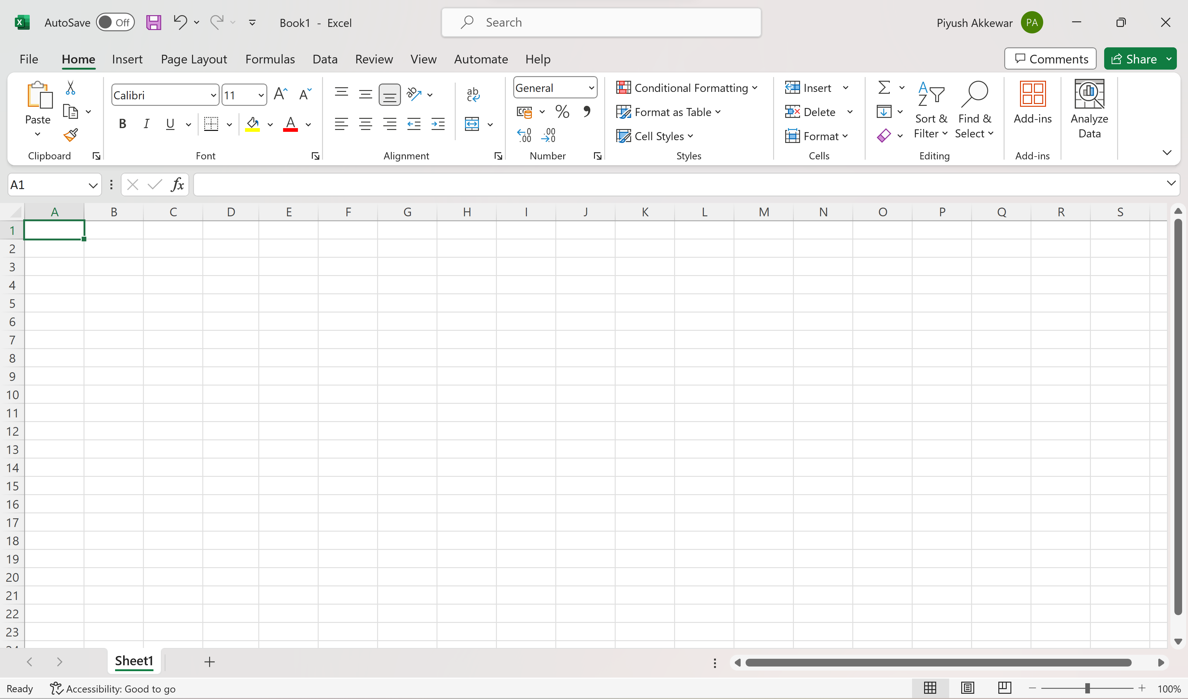
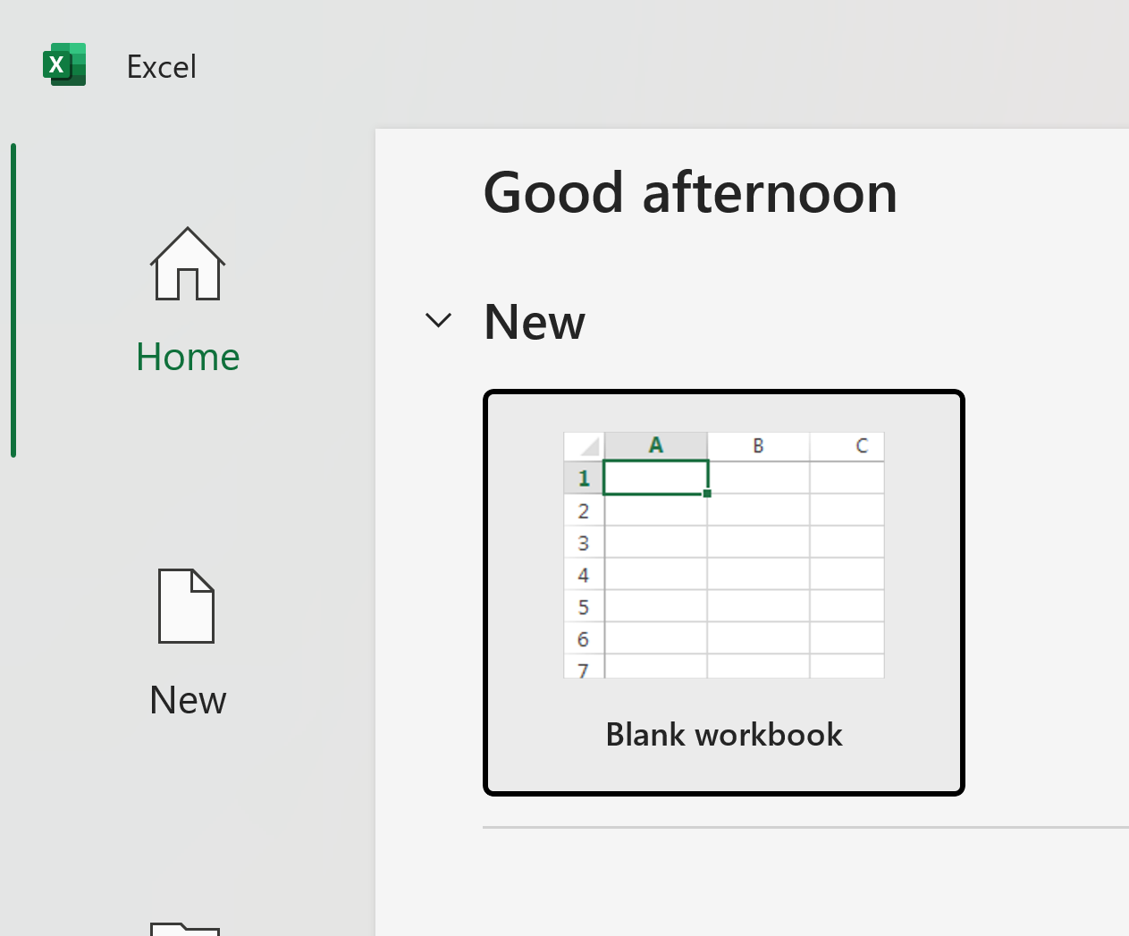
Cont…
Tabs

Slide 9
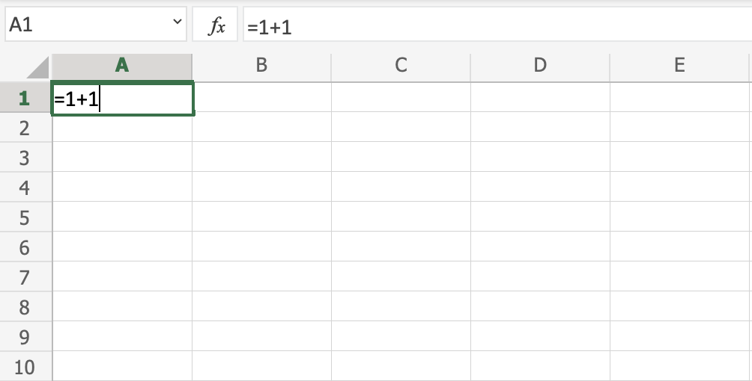
Excel Overview
Let's make a function!
First, double click the cell A1, the one that is marked with the green rectangle in the picture.
Second, type =1+1.
Third, hit the enter button

Slide 10
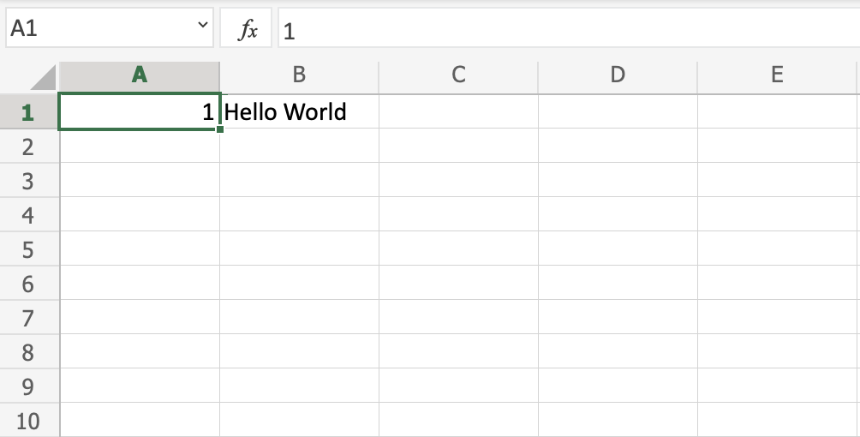
Excel Overview
The Sheet
The Sheet is a set of rows and columns. It forms the same pattern as we have in math exercise books, the rectangle boxes formed by the pattern are called cells.
Values can be typed to cells.

Slide 11
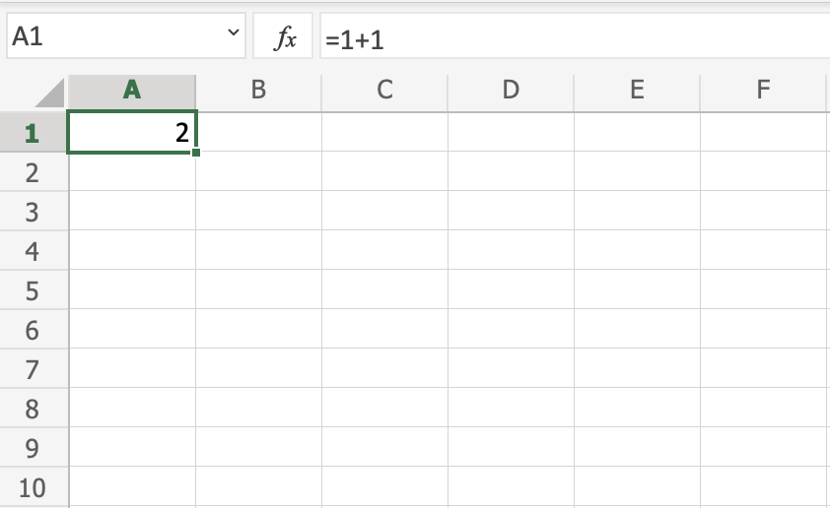
Excel Syntax
Syntax: A formula in Excel is used to do mathematical calculations. Formulas always start with the equal sign = typed in the cell, followed by your calculation.
Creating formulas, step by step
Select a cell
Type the equal sign (=)
Select a cell or type value
Enter an arithmetic operator
Select another cell or type value
Press enter
For example: In cell =1+1 is the formula to calculate 1+1=2

Slide 12
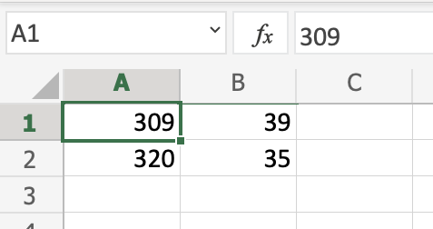
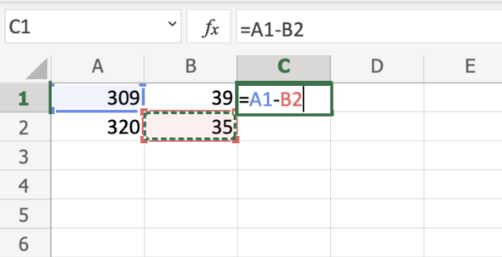
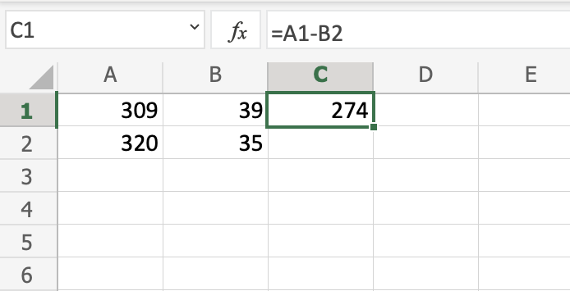
Cont…
Using Formulas with Cells
You can type values to cells and use them in your formulas.
Select the cell C1
Type the equal sign (=)
Left click on A1, the cell that has the (309) value
Type the minus sign (-)
Left click on B2, the cell that has the (35) value
Hit enter

Slide 13
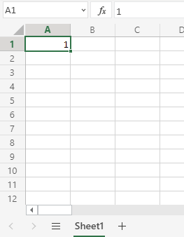
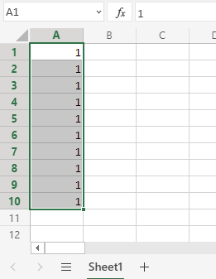
Excel Fill
We have typed the value A1(1)
Click on A1 -> Drag & Drop till A10
Filling makes your life easier and is used to fill ranges with values, so that you do not have to type manual entries.
Filling can be used for
Copying
Sequences
Dates
Functions (*)

Slide 14
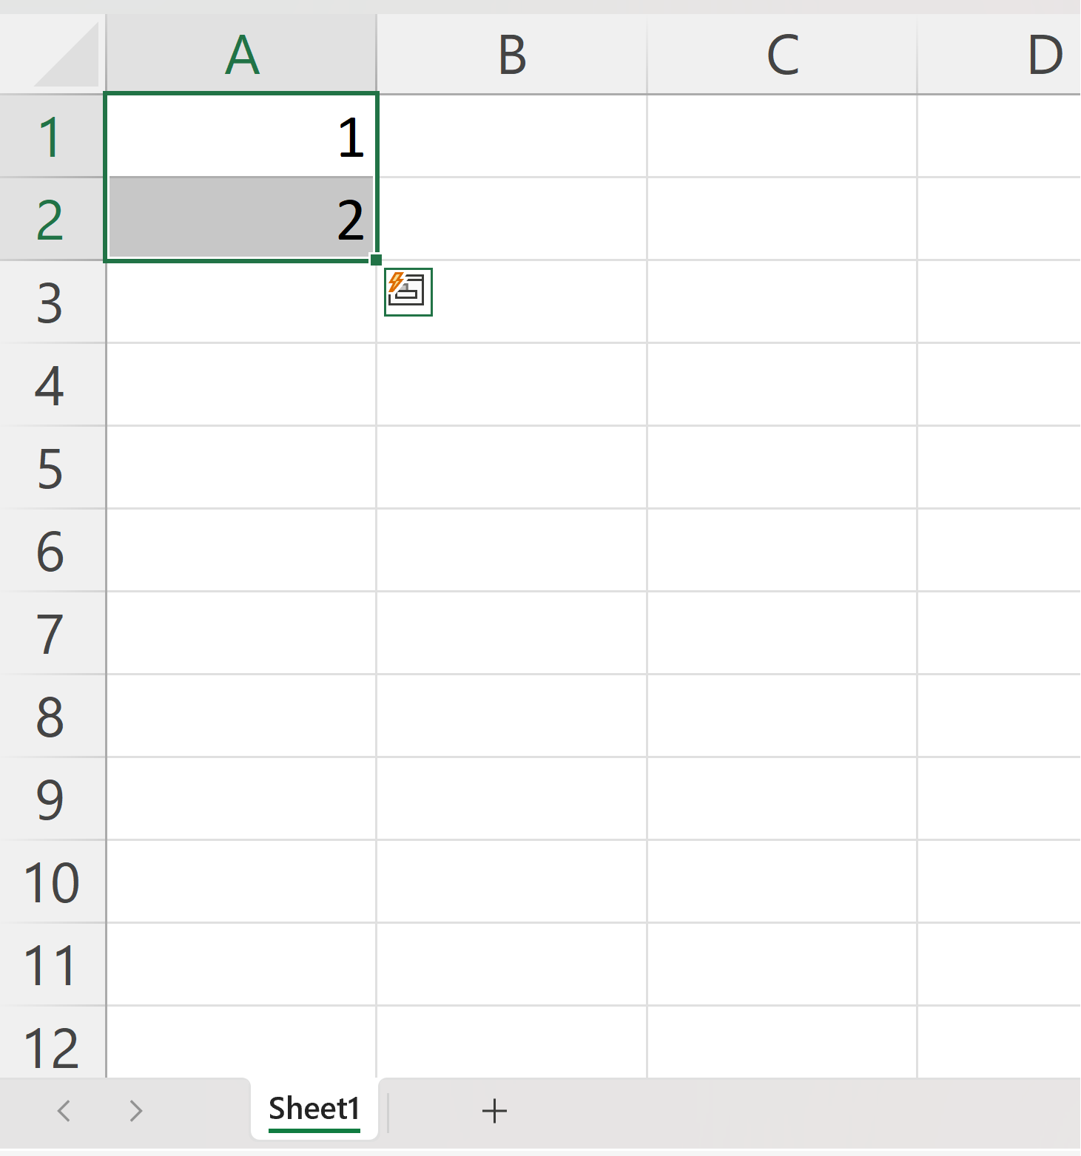
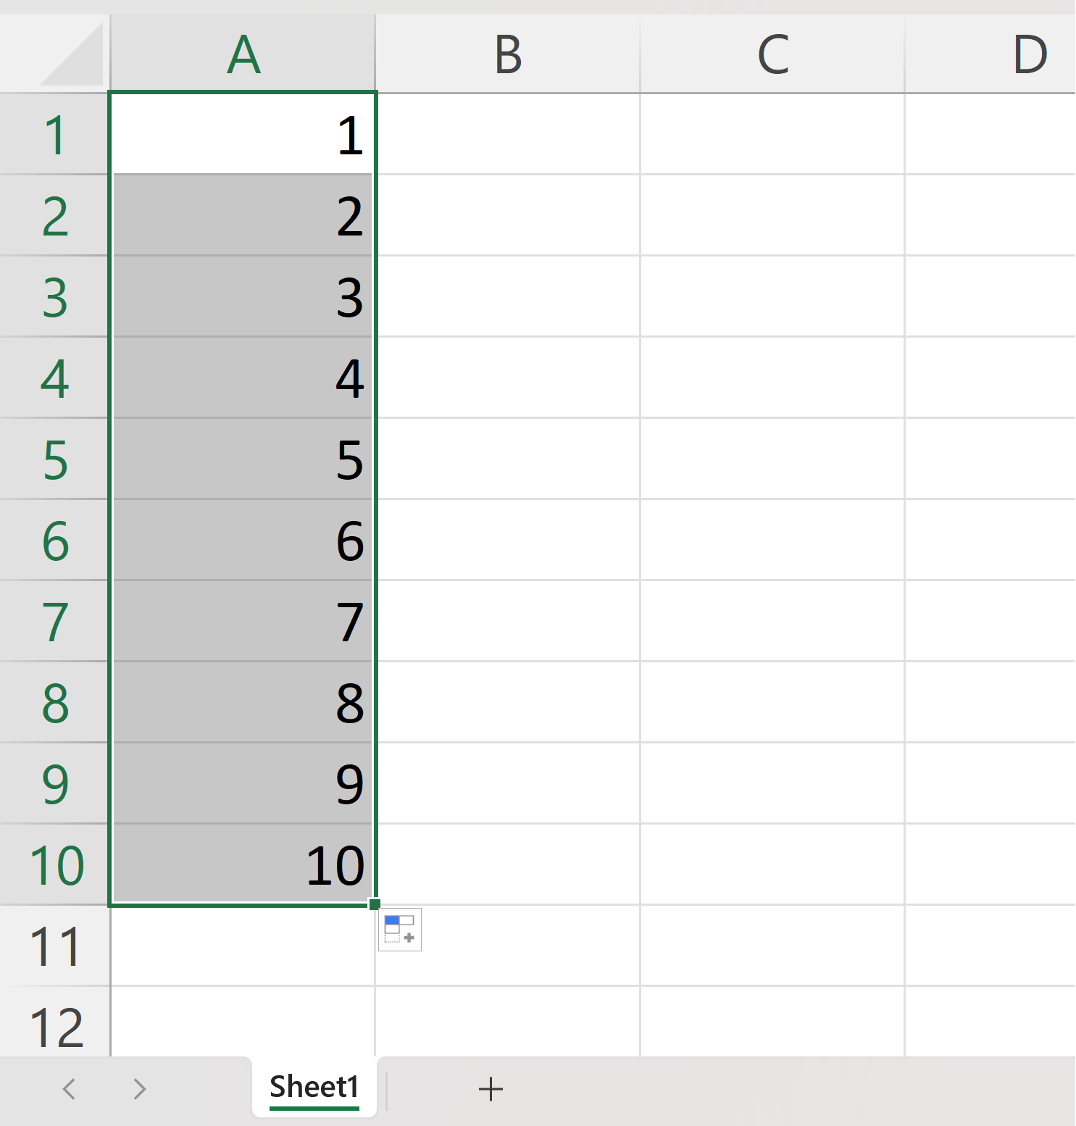
Cont.…
We have typed the value A1(1) & A2(2)
Select cell on A1 & A2 -> Drag & Drop till A10
Fill Sequences

Slide 15
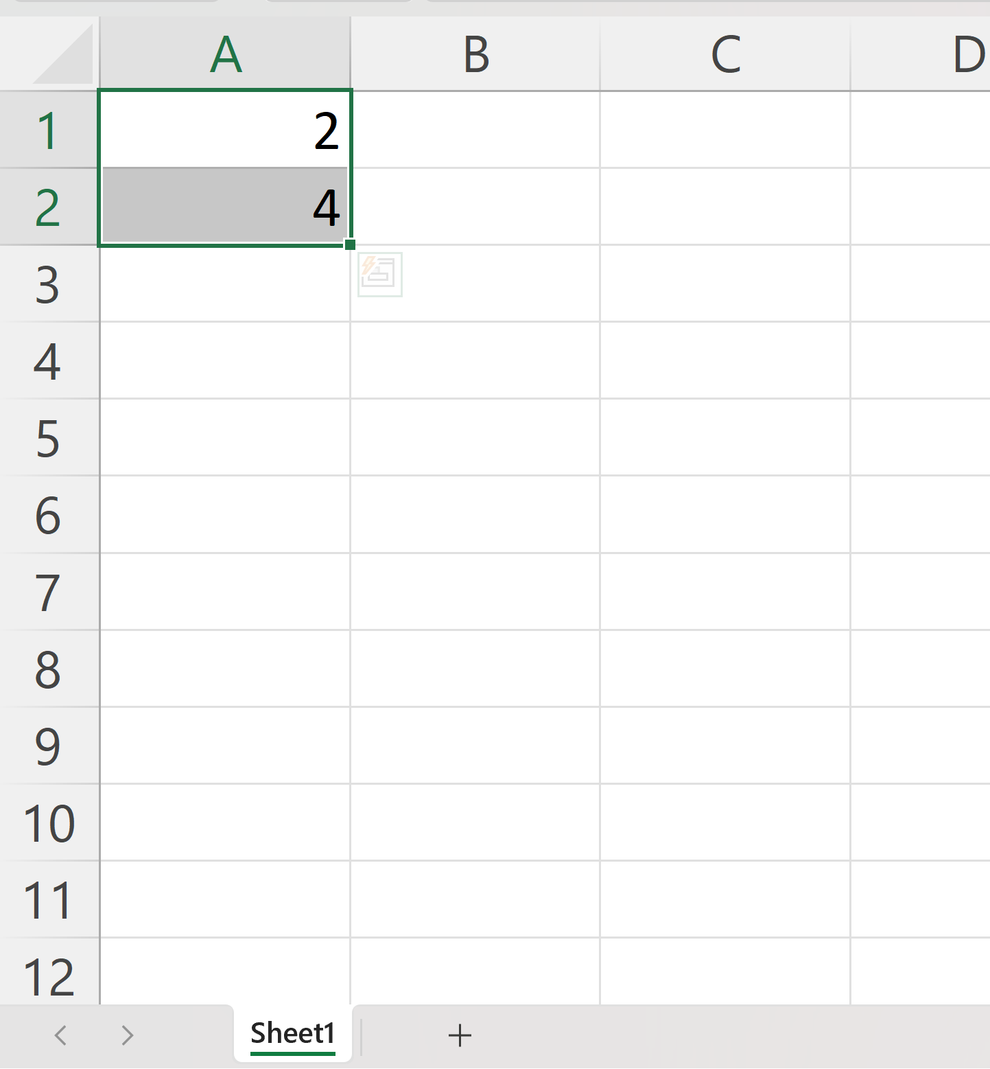
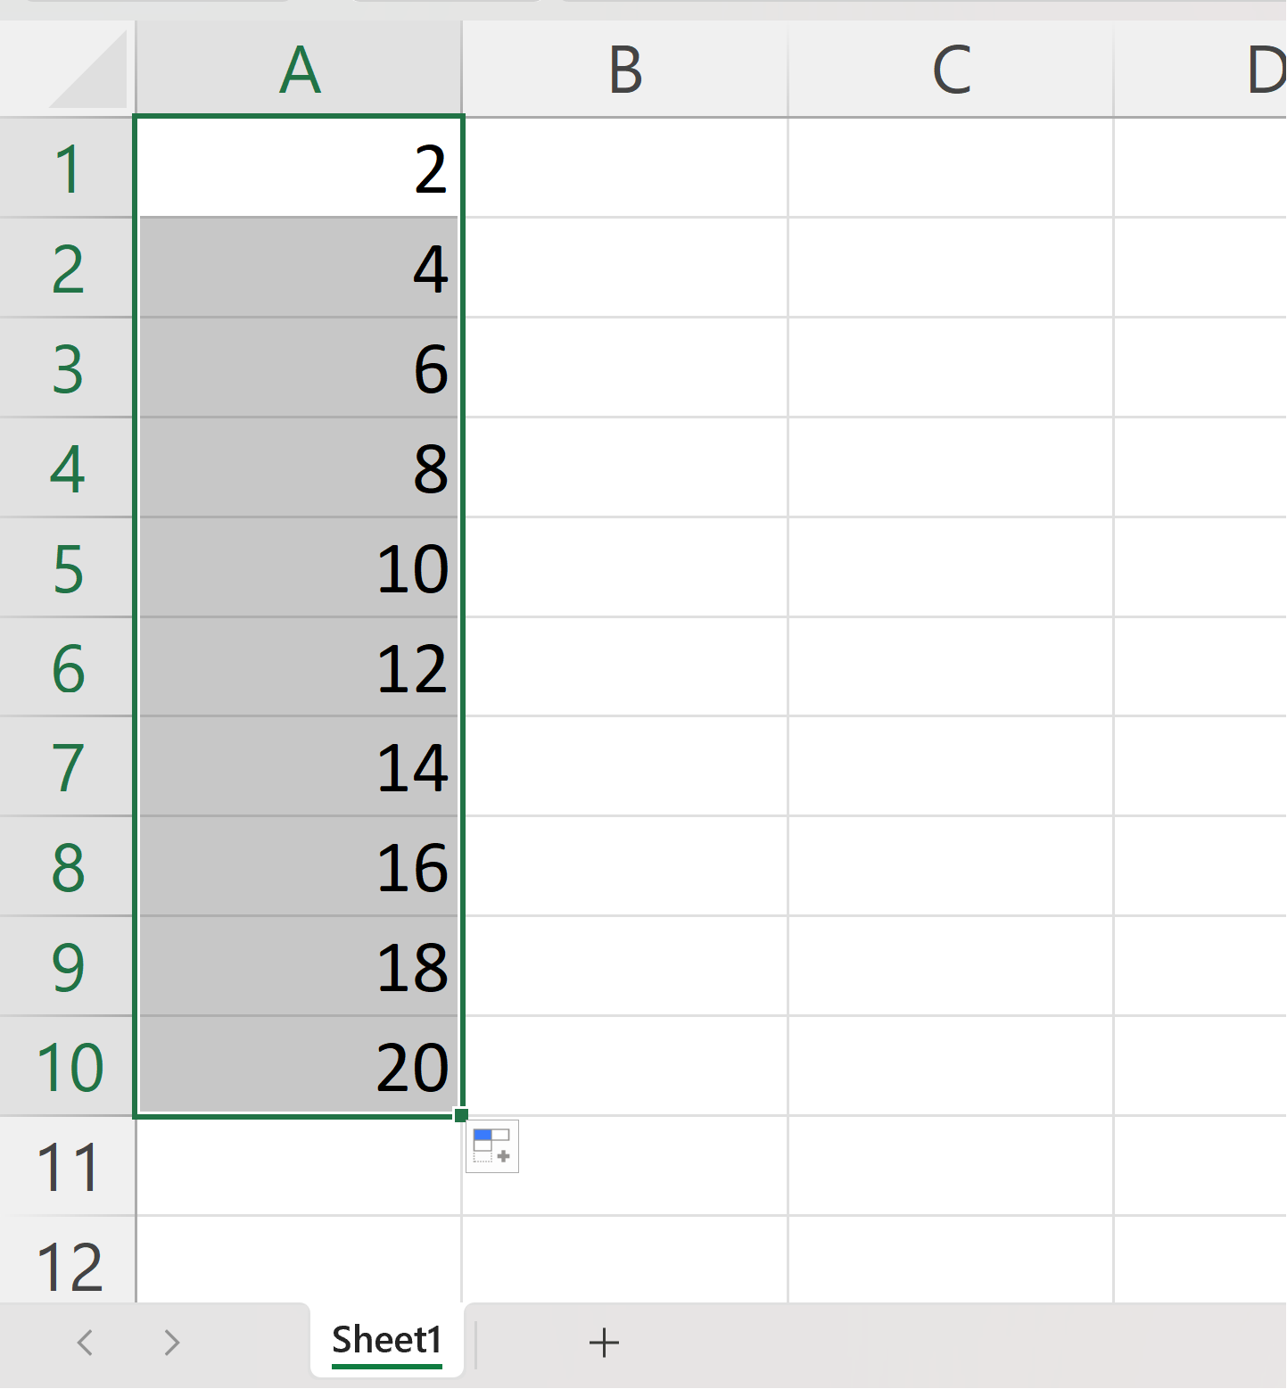
Cont.…
We have typed the value A1(2) & A2(4)
Select cell on A1 & A2 -> Drag & Drop till A10
Fill Sequences

Slide 16
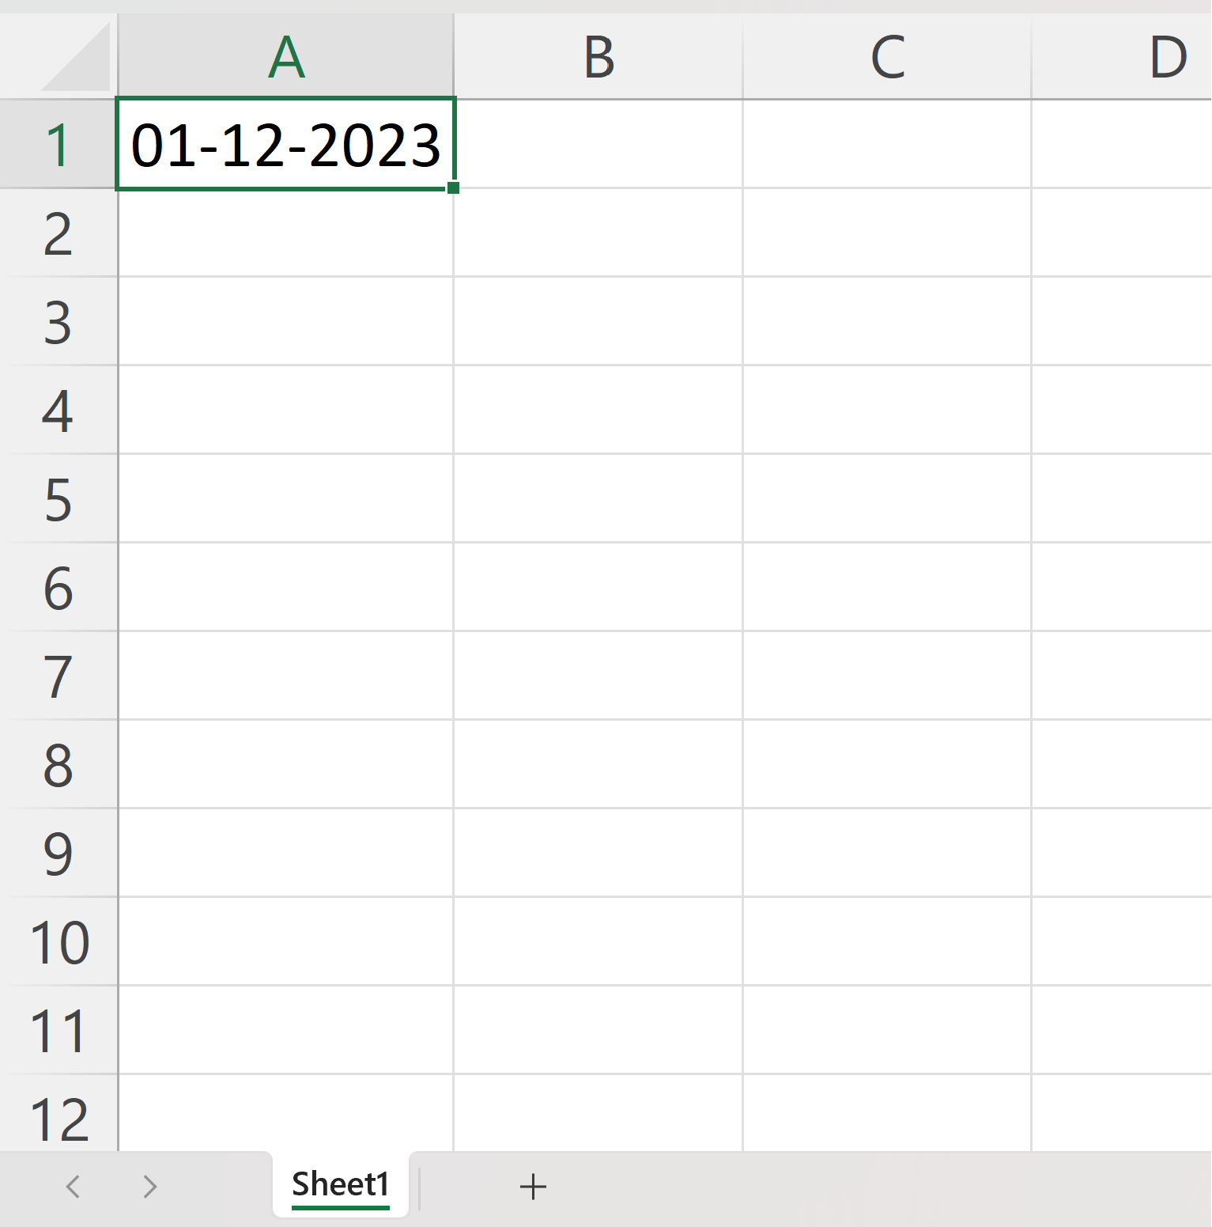
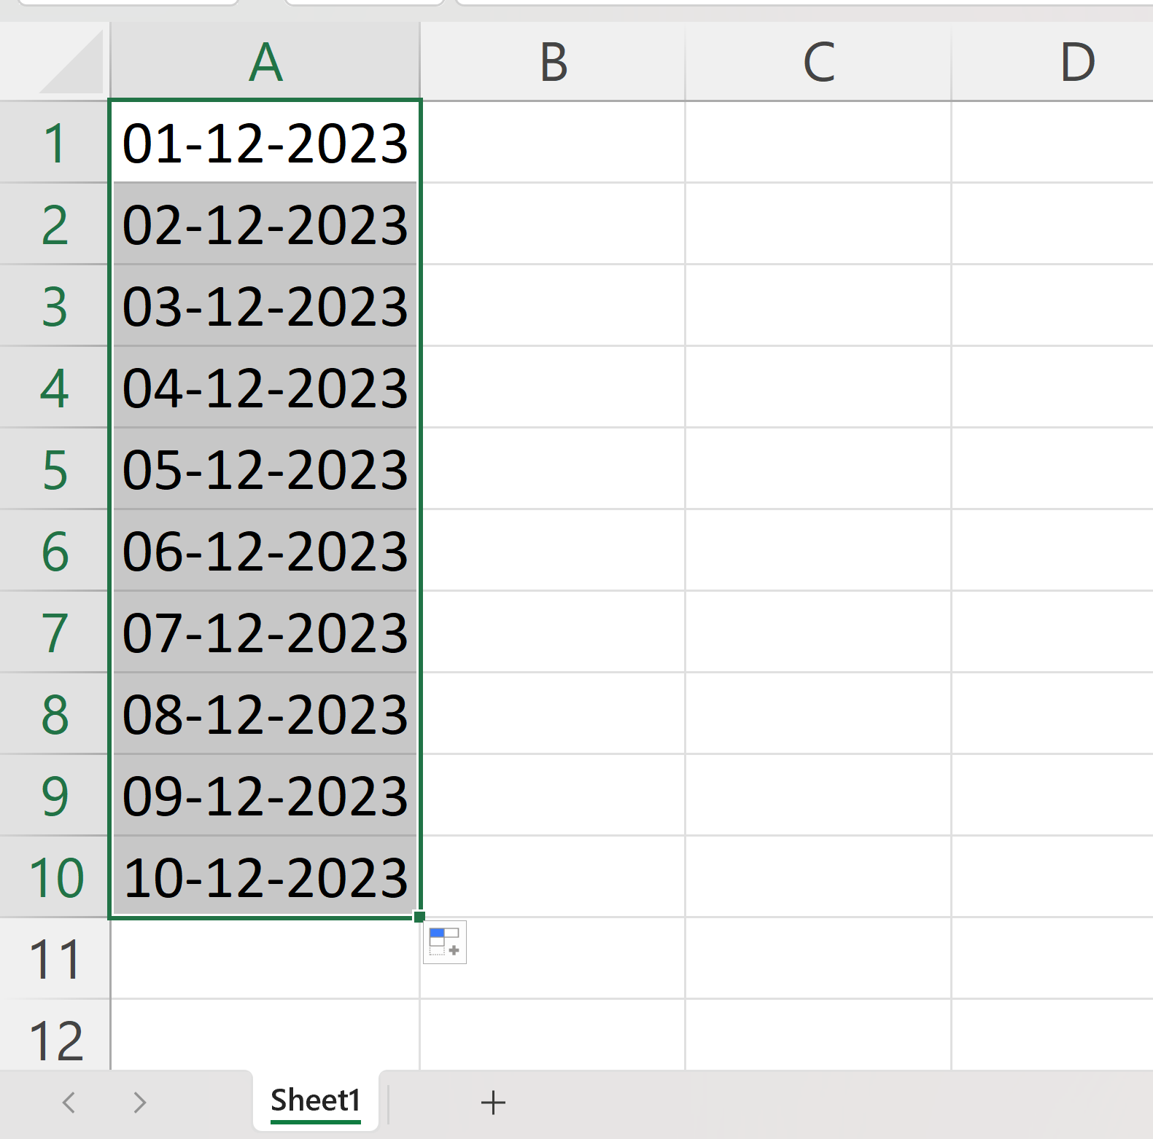
Cont.…
We have typed date value A1(01-12-2023)
Select cell on A1 -> Drag & Drop till A10
Sequences of Dates

Slide 17
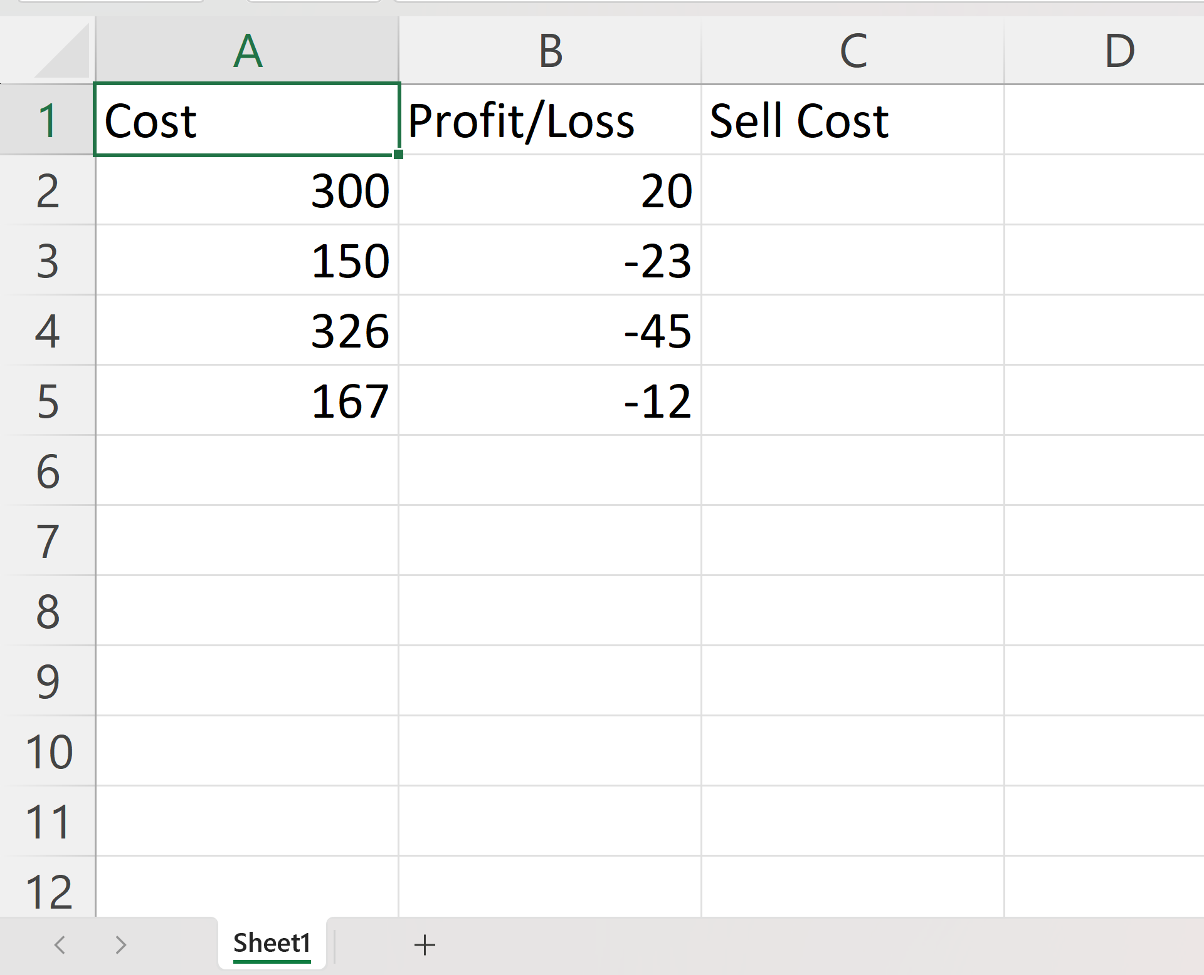
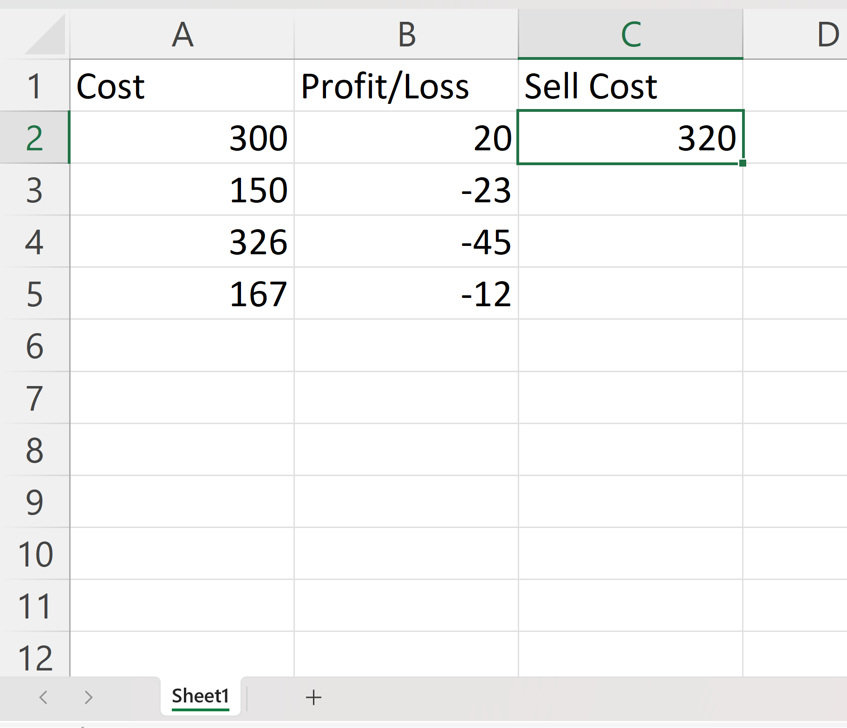
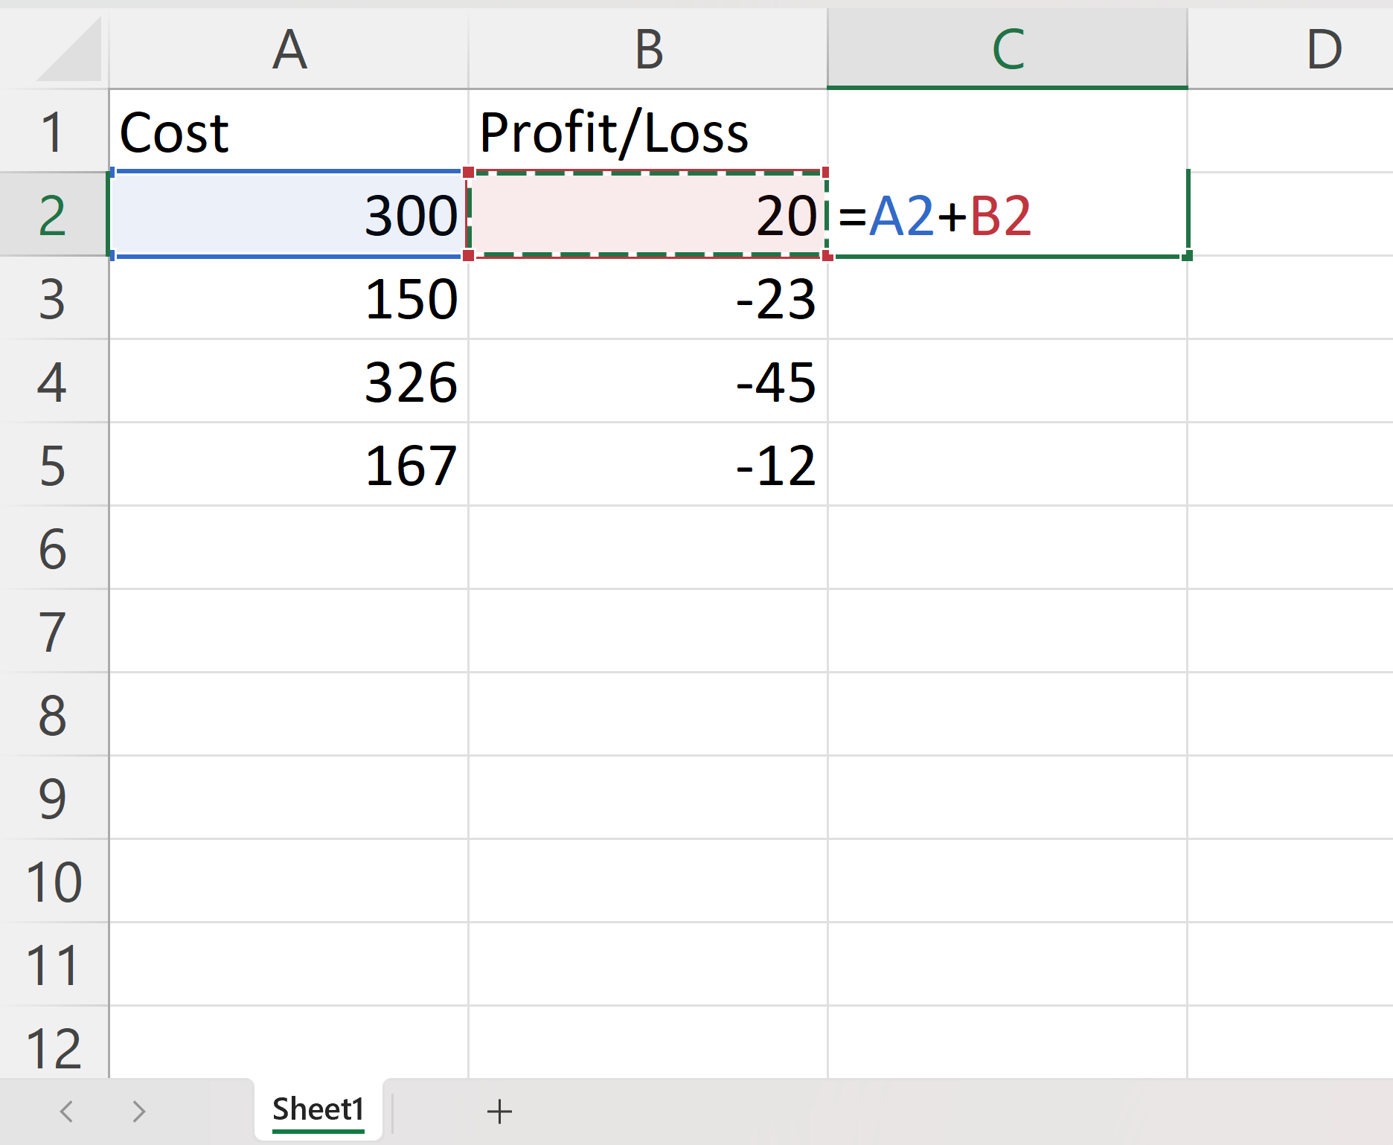
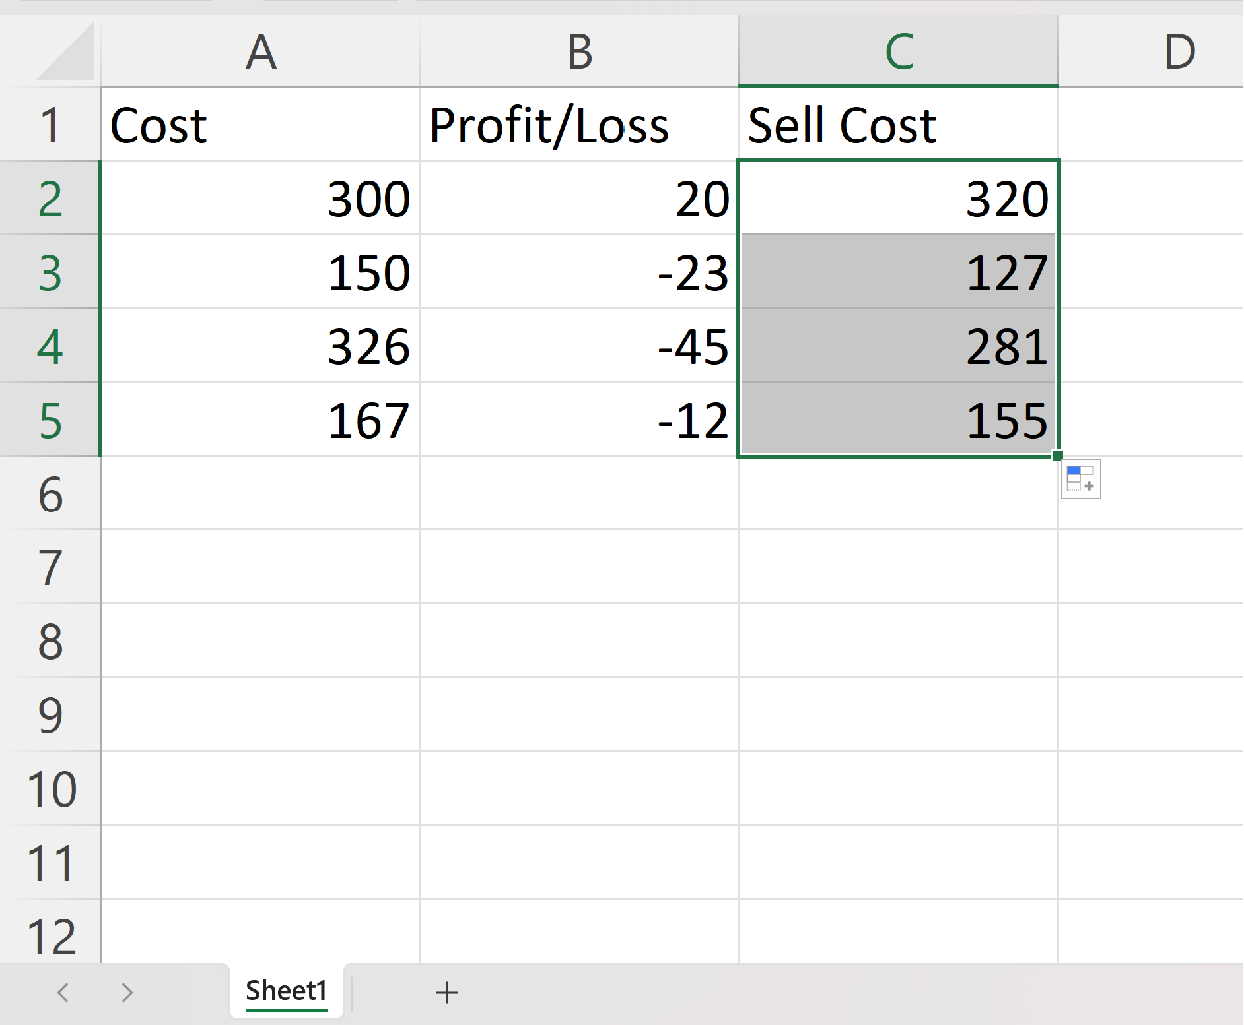
Cont.…
Double Click to Fill
Select C2
Type =
Select A2
Type +
Select B2
Hit enter
Double click the fill function
1
3
2
3

Slide 18
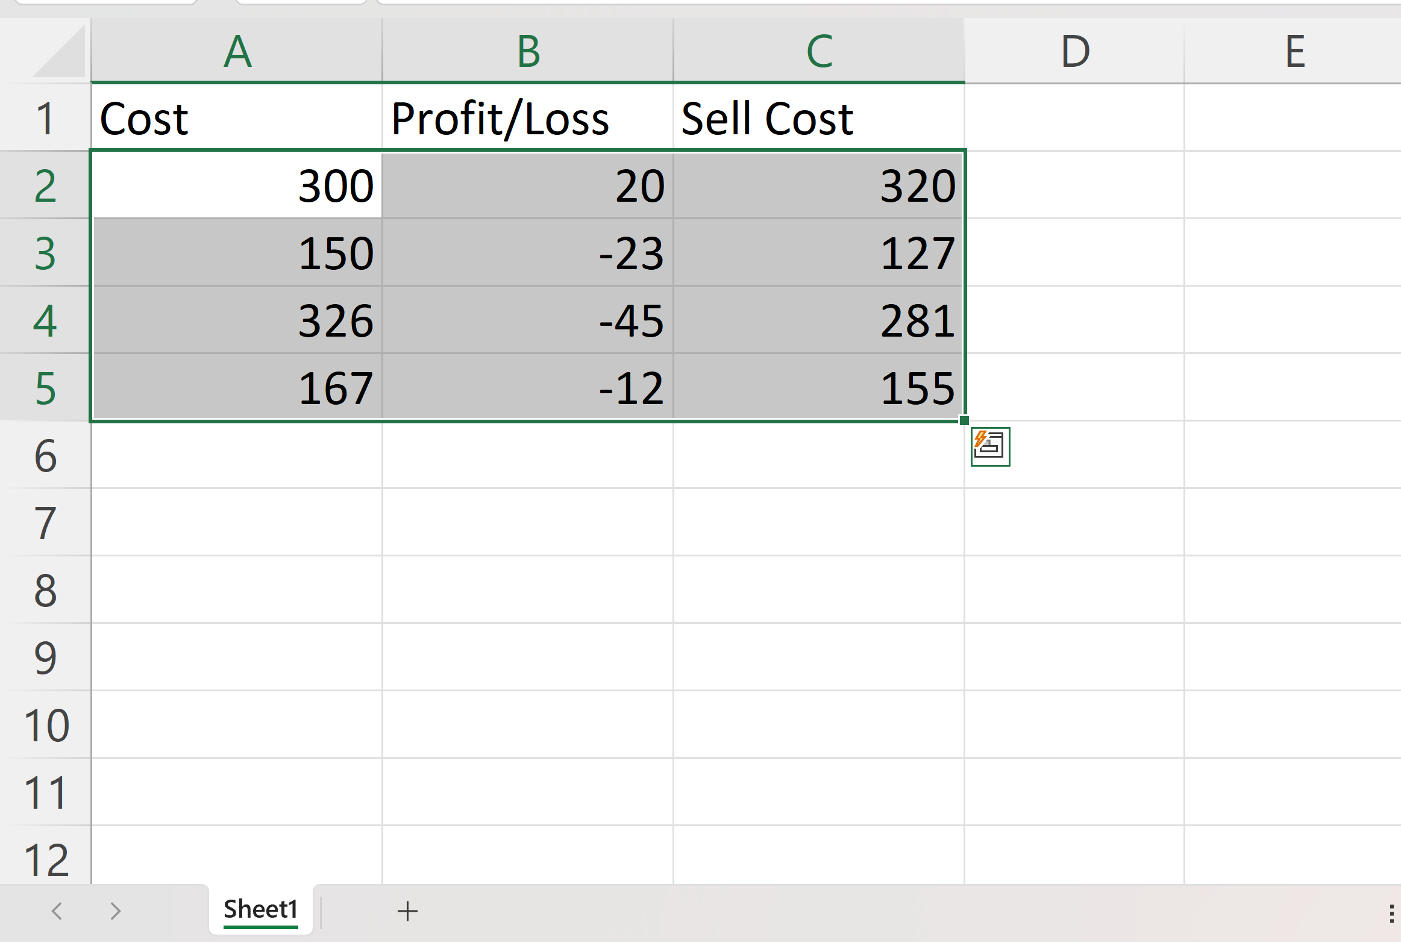
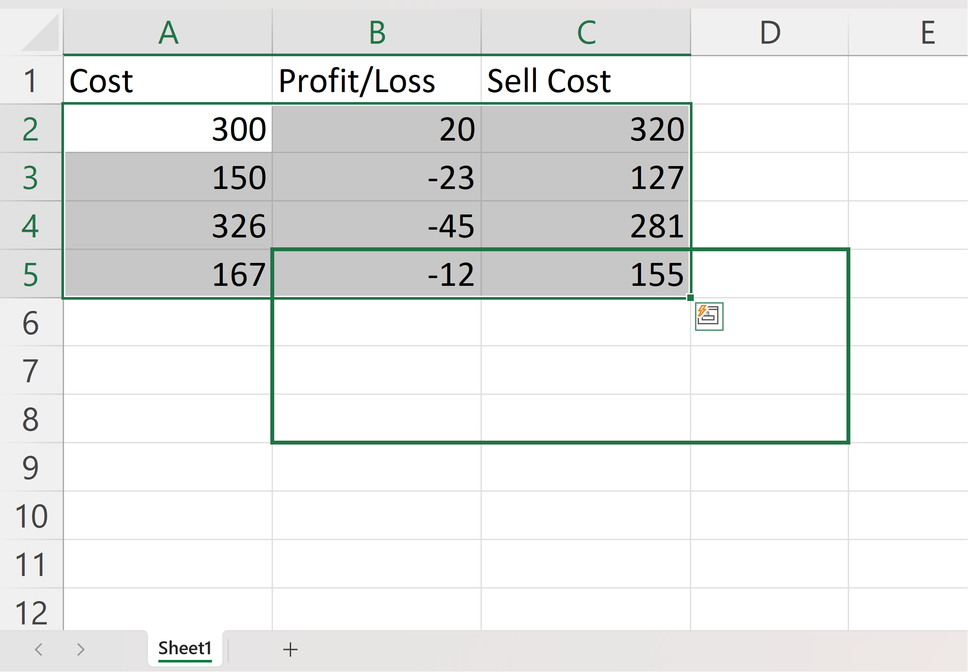
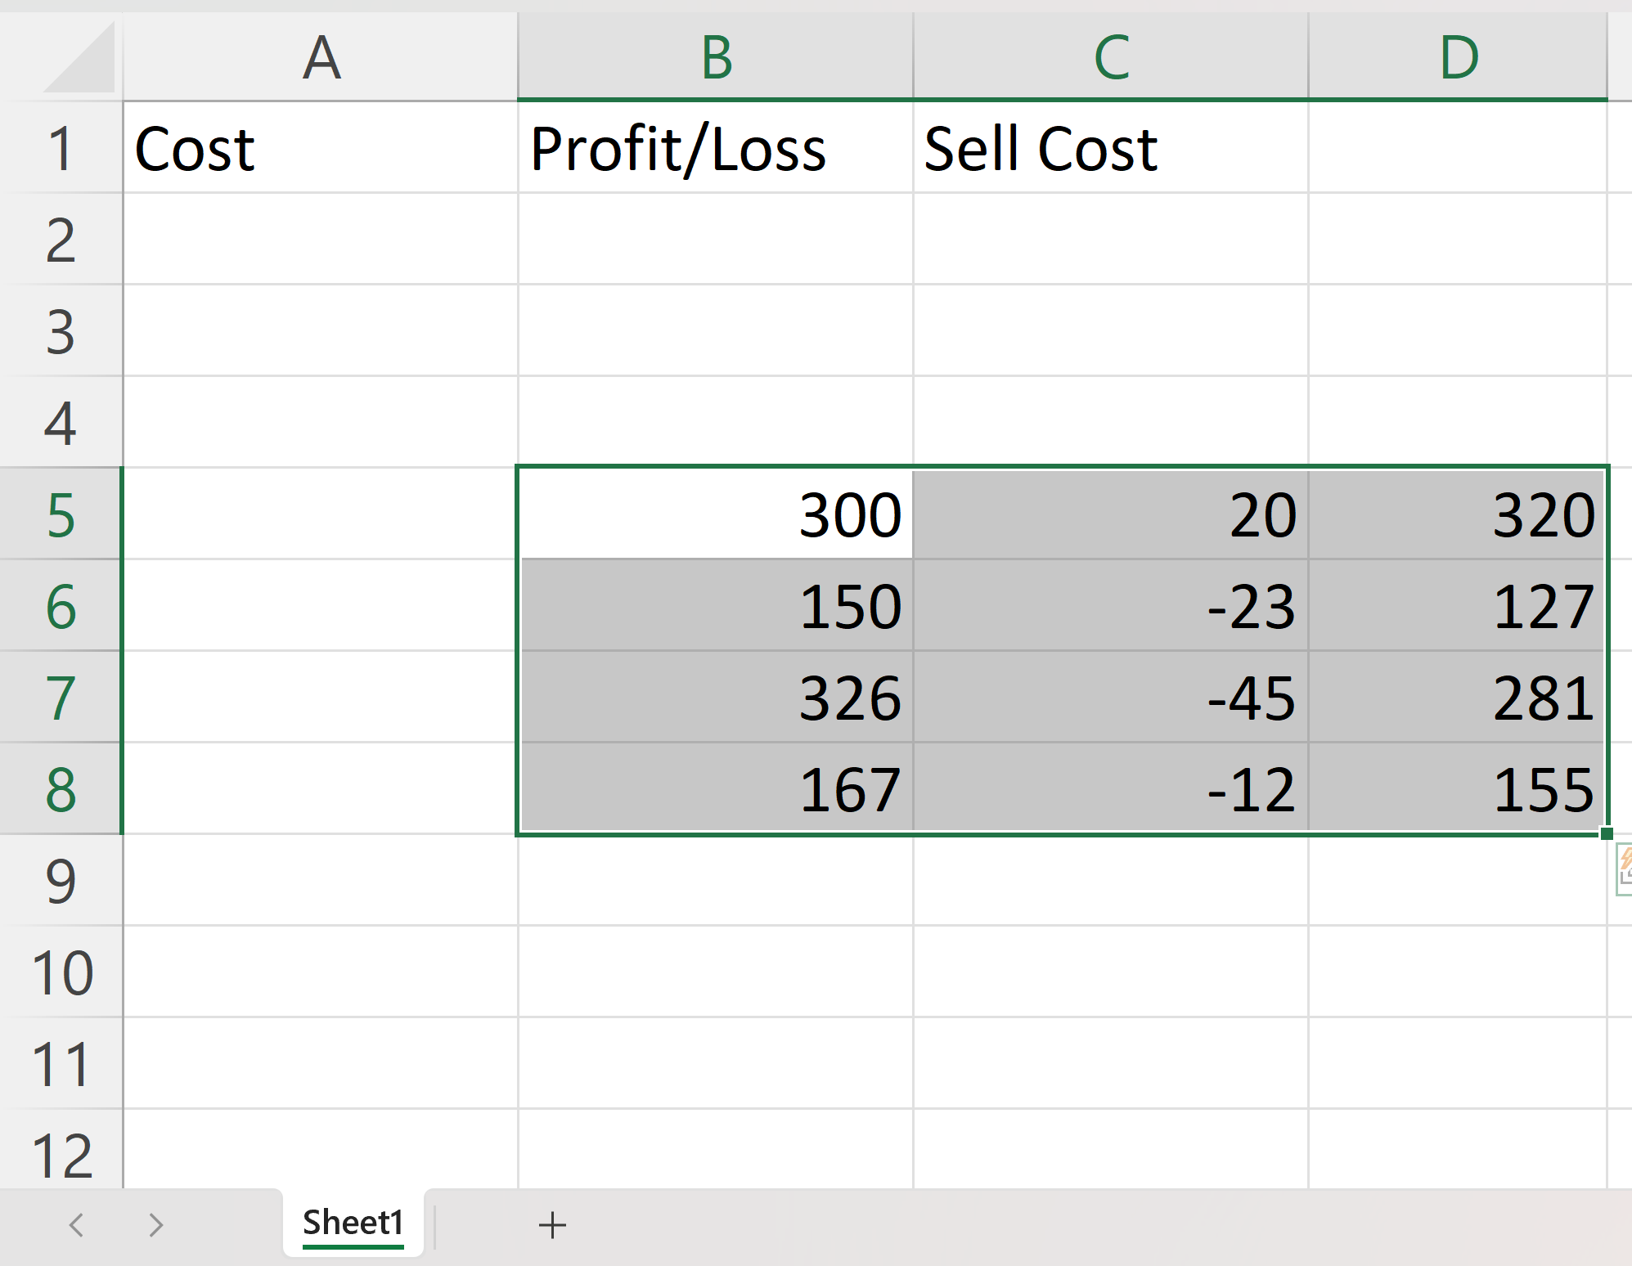
Basic Cell Operations
Excel Move Cells
There are two ways to move cells: Drag and drop or by copy and paste.
Drag and Drop: Select cell/cells, then drop and drop to desired location
Copy & Paste: Select cell/cells, then ctrl+x and then ctrl+p at desired location
1
2
3

Slide 19
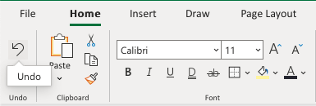
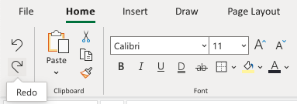
Basic Cell Operations
Excel Add Cells
Adding New Columns: Right click on the column and select "Insert Columns"
Adding New Rows: Right click on the column and select "Insert Rows"
Excel Delete Cells
Click on Delete Button
Excel Undo and Redo
Undo: CTRL + Z / Command + Z
Redo: CTRL + Y / Command + Y

Slide 20
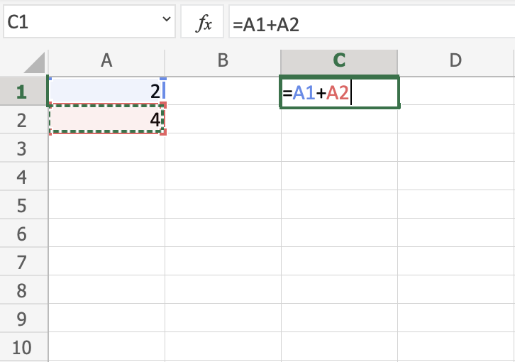
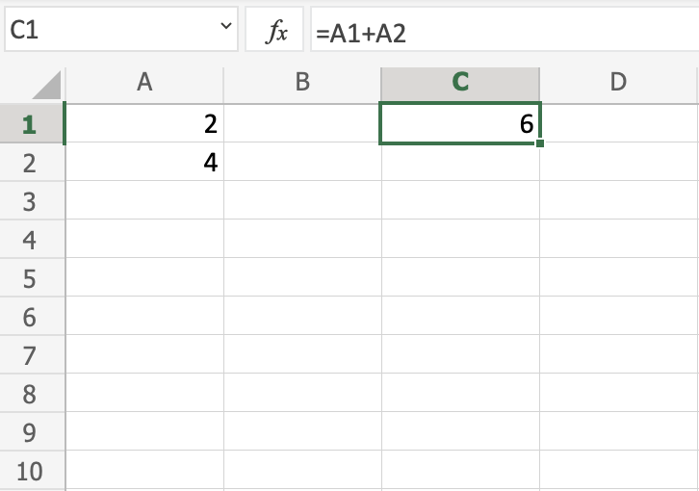
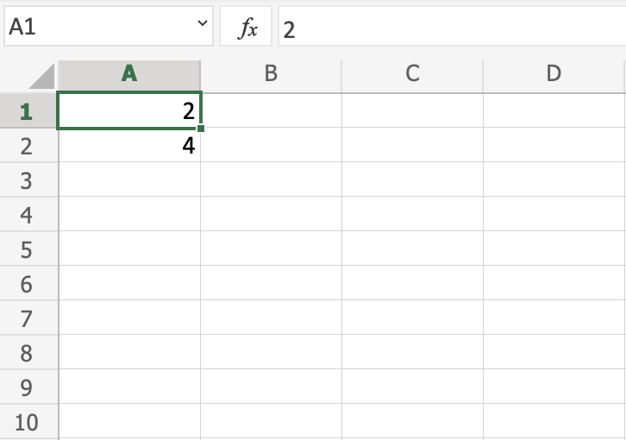
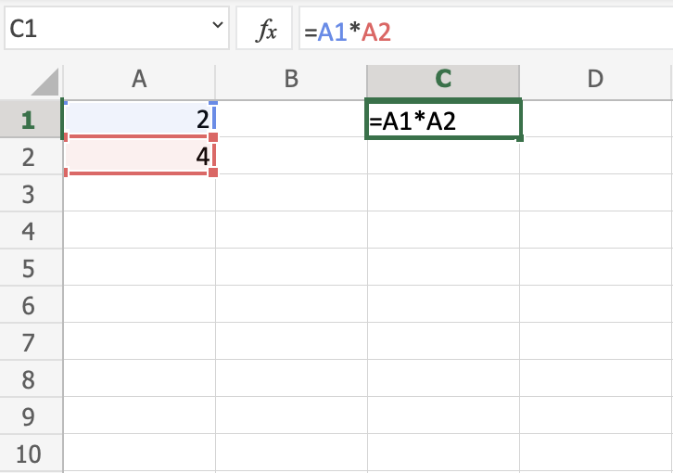
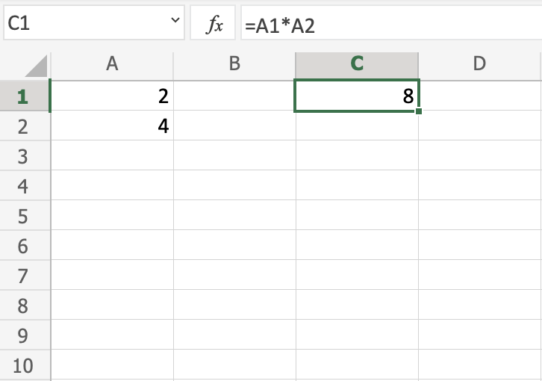
Excel Formulas
A formula in Excel is used to do mathematical calculations
Formulas can be used for calculations such as
= 1+1
= 2*2
= 4/2 =2

Slide 21
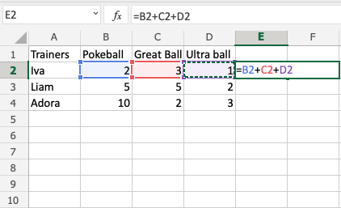
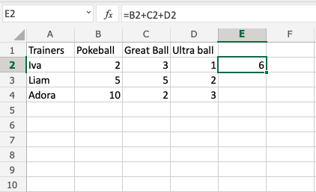
Cont.
Step 1
Select cell E2 and type (=)
Left click B2 and Type (+)
Left click C2 and Type (+)
Left click D2
Hit enter
Step 2
Select E2
Fill E2:E4
Step 01
Step 02

Slide 22
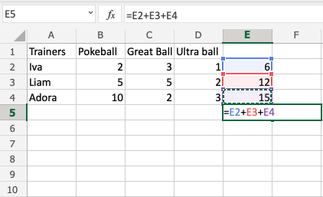
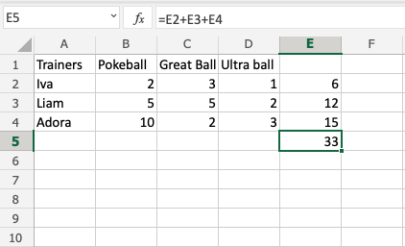
Cont.
Step 3
Select cell E5, and type =
Left click E2
Type (+)
Left click E3
Type (+)
Left click E4
Hit enter

Slide 23

Basic Functions (SUM, COUNT, AVERAGE, etc.)

Slide 24
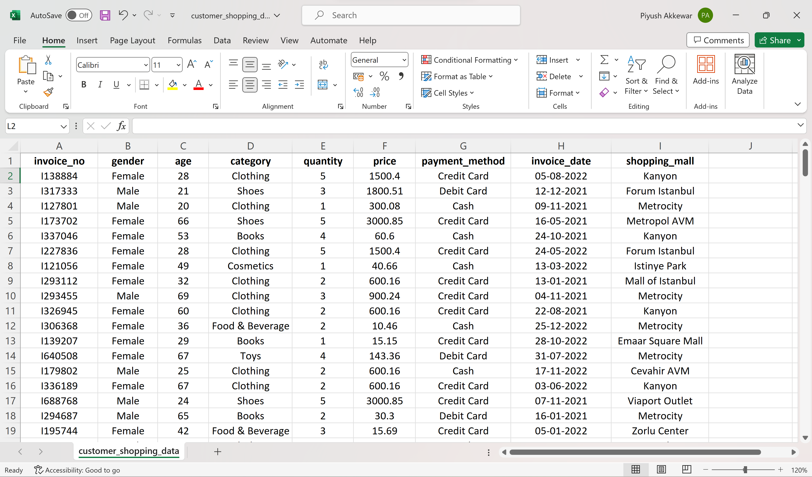
Basic Excel Functions
Dataset customer_shopping_data

Slide 25
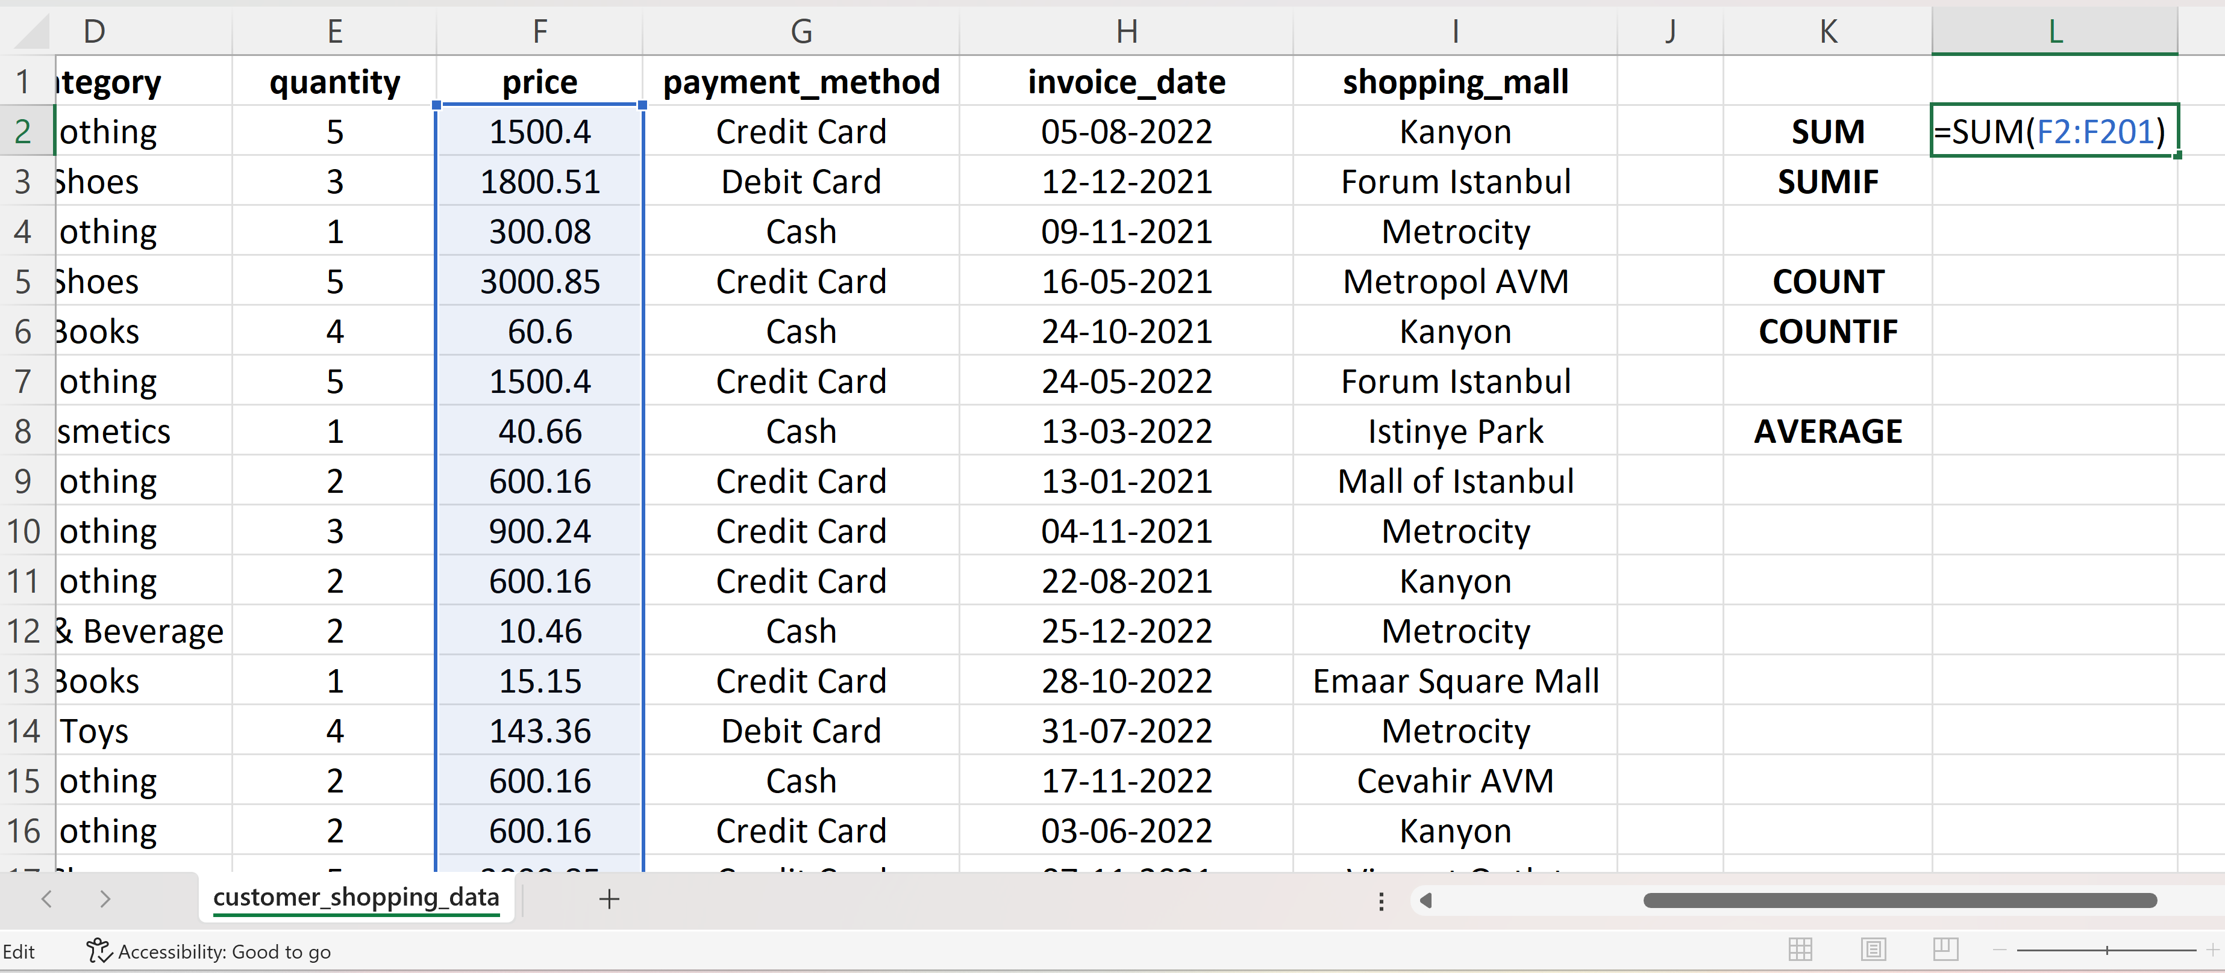
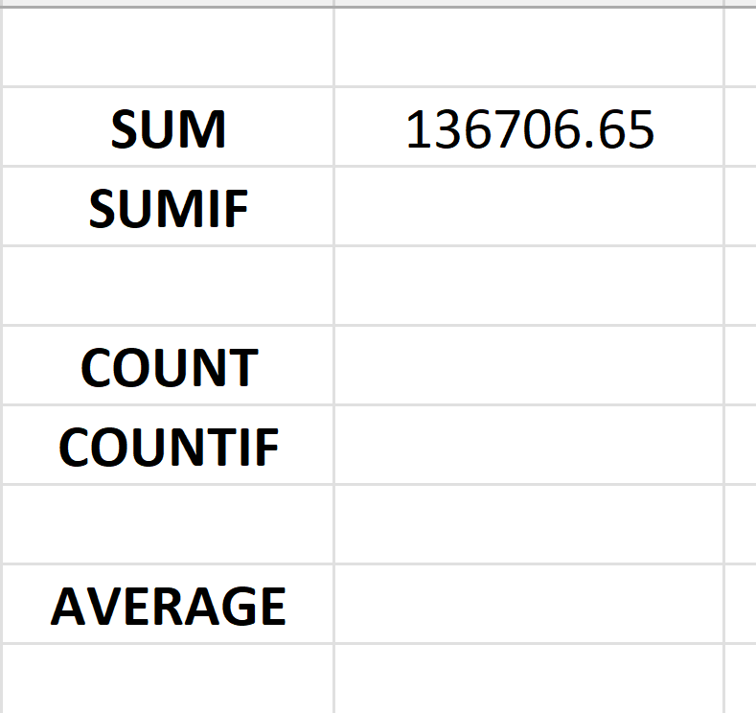
Cont…
SUM Function
Purpose: Adds up a range of numbers.
Usage: = SUM(range)
Example: =SUM(A1:A5) adds the values in cells A1 through A5.

Slide 26
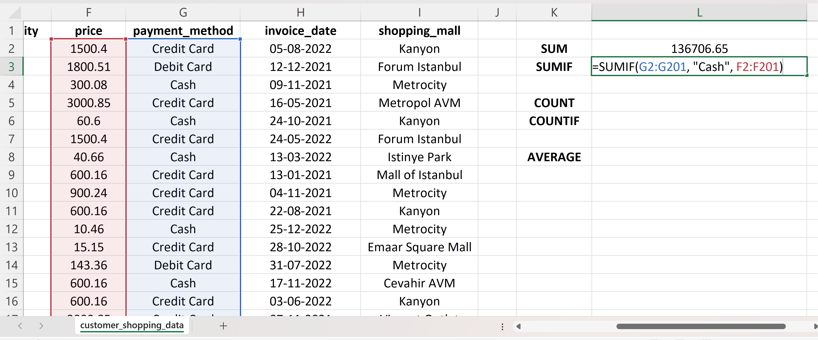
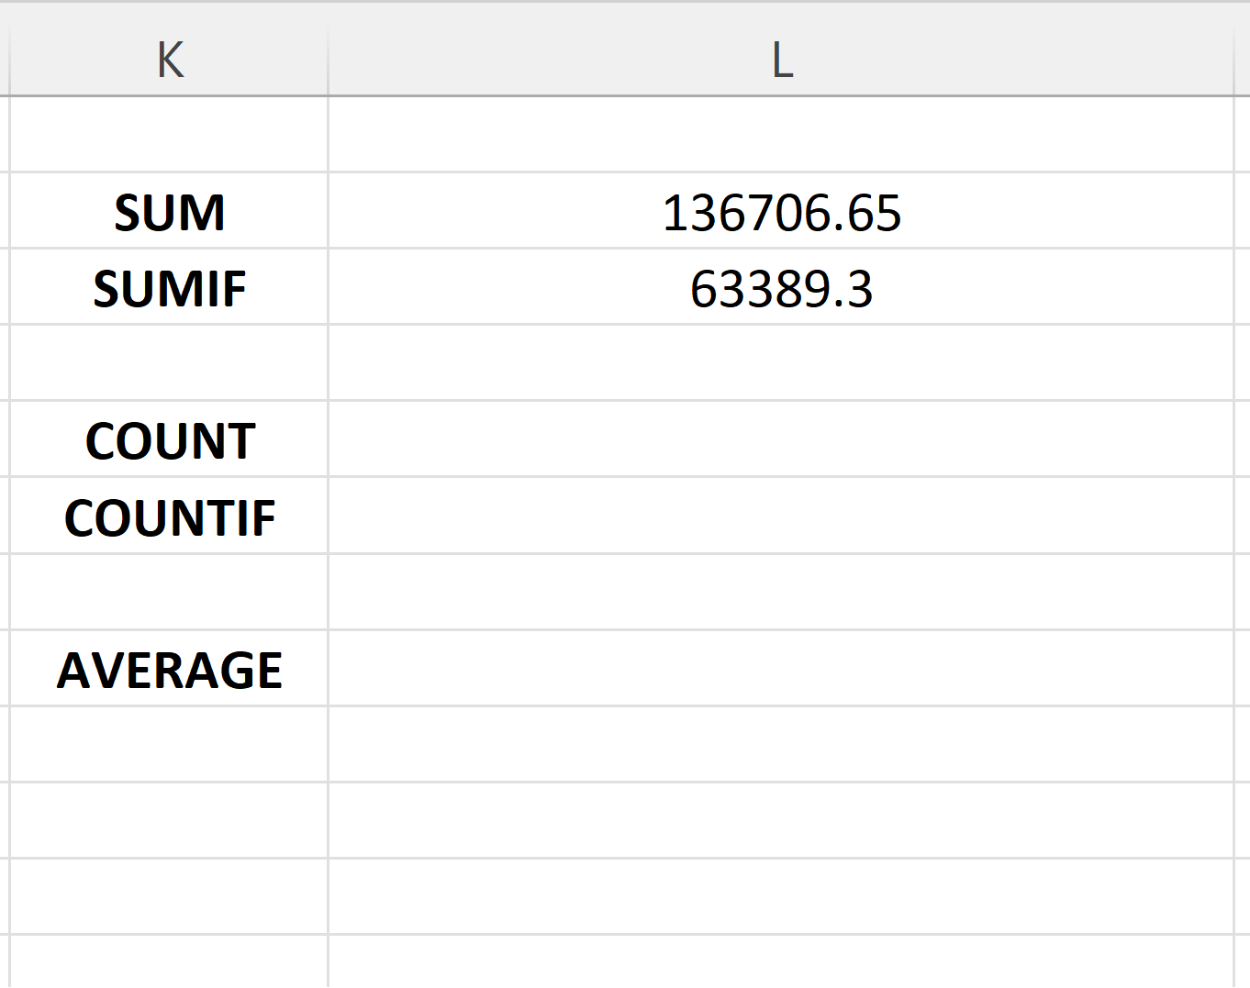
Cont…
SUMIF Function
Purpose: Adds numbers in a range based on a specific condition.
Usage: = SUMIF(range, criteria, [sum_range])
Example: = SUMIF(A1:A5, ">10") sums values in A1 to A5 that are greater than 10.

Slide 27
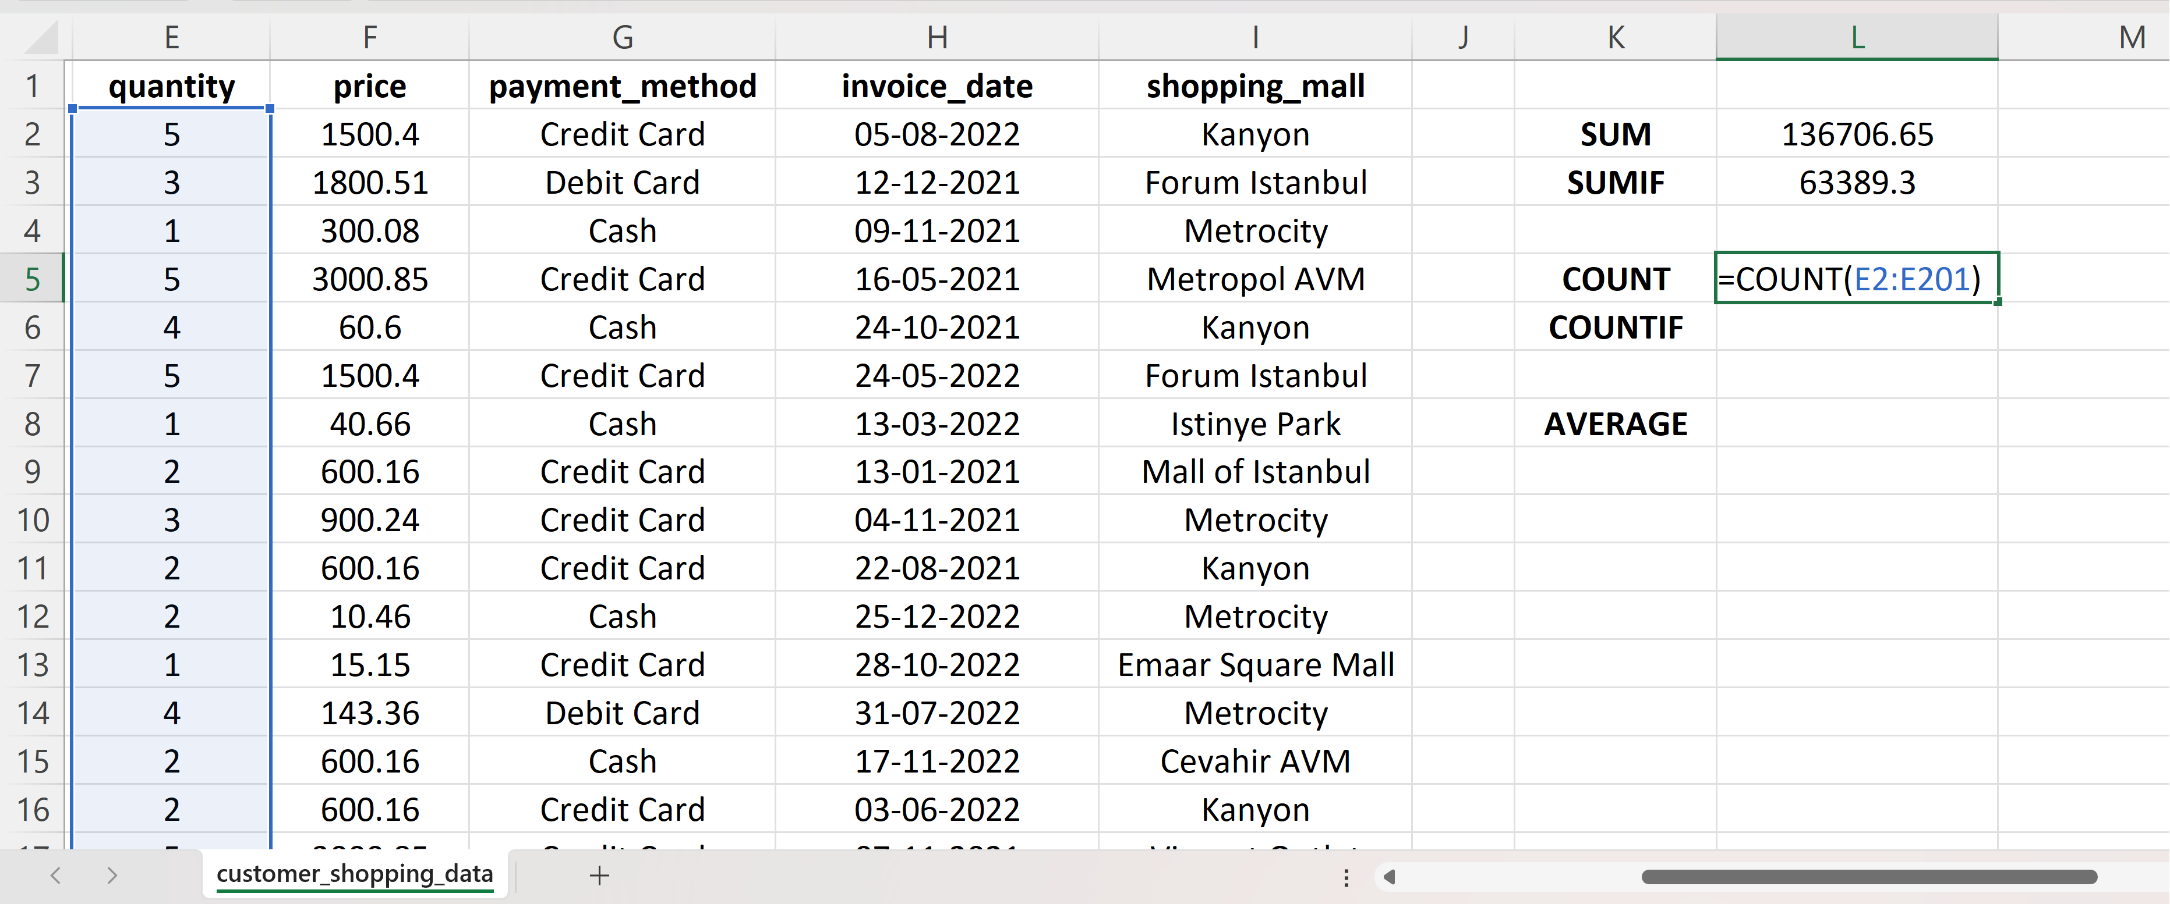
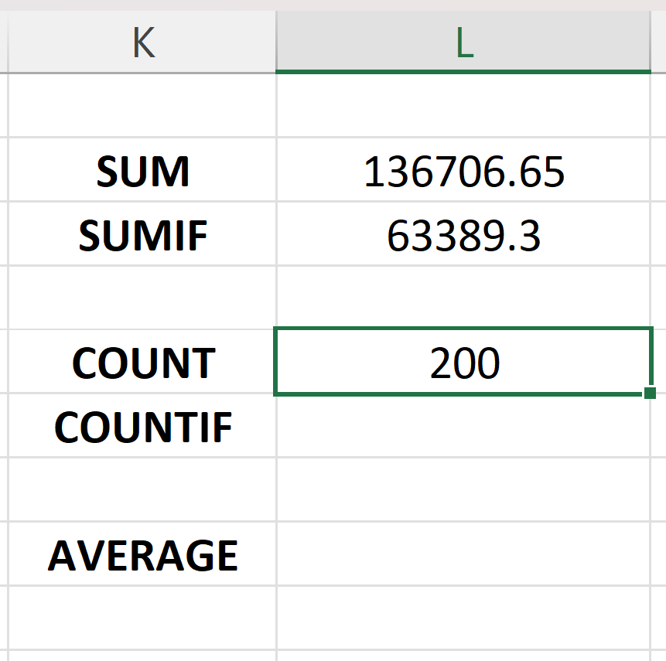
Cont…
COUNT Function
Purpose: Counts the number of cells that contain numbers.
Usage: =COUNT(range)
Example: =COUNT(A1:A5) counts how many cells in A1 to A5 contain numbers.
0.

Slide 28
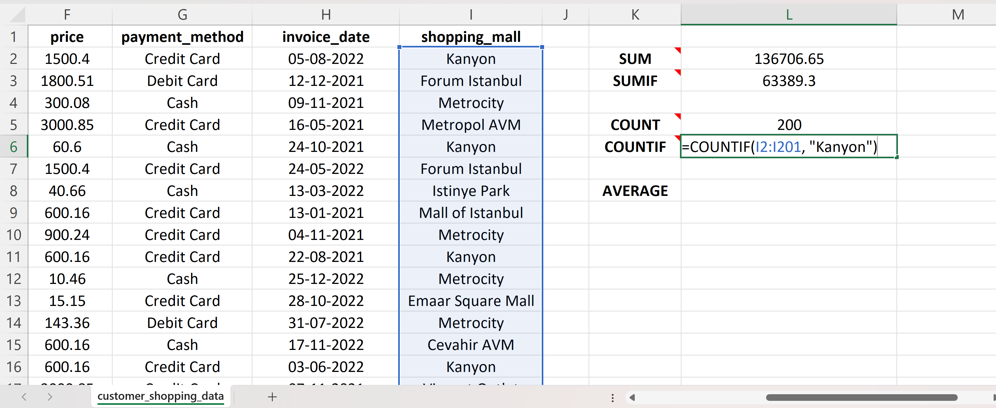
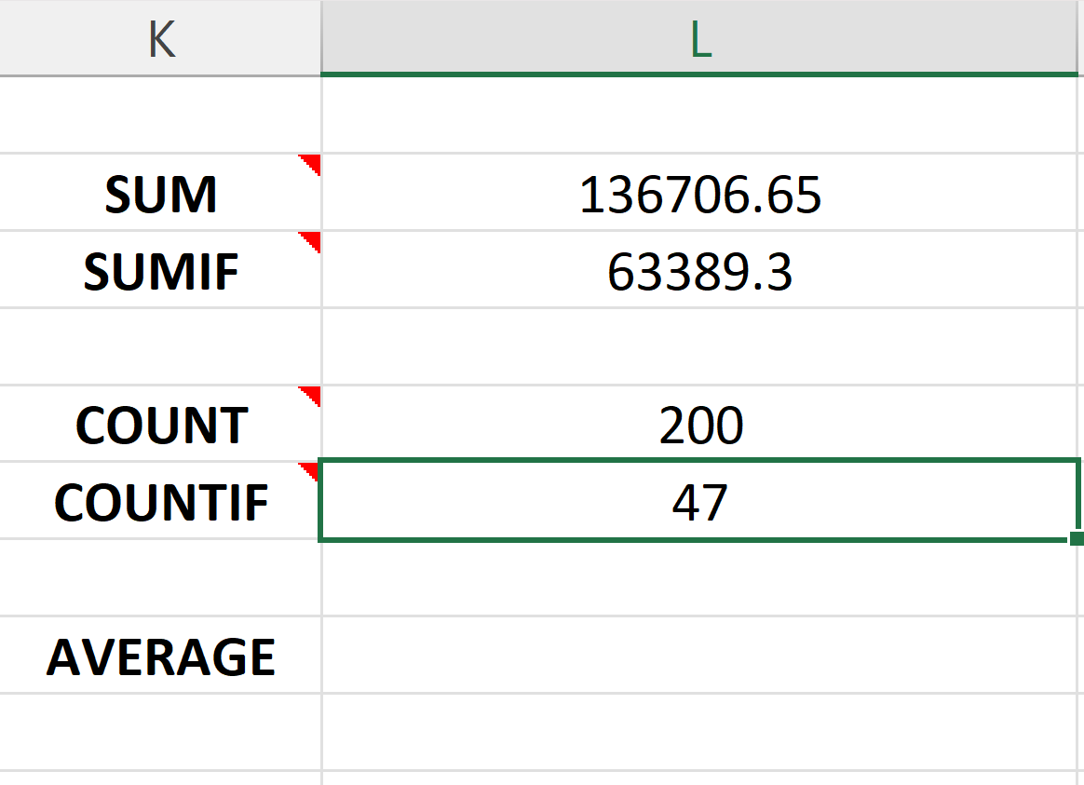
Cont…
COUNTIF Function
Purpose: Counts cells in a range that meet a specific condition.
Usage: =COUNTIF(range, criteria)
Example: =COUNTIF(A1:A5, “<5”) counts cells in A1 to A5 that are less than 5.

Slide 29
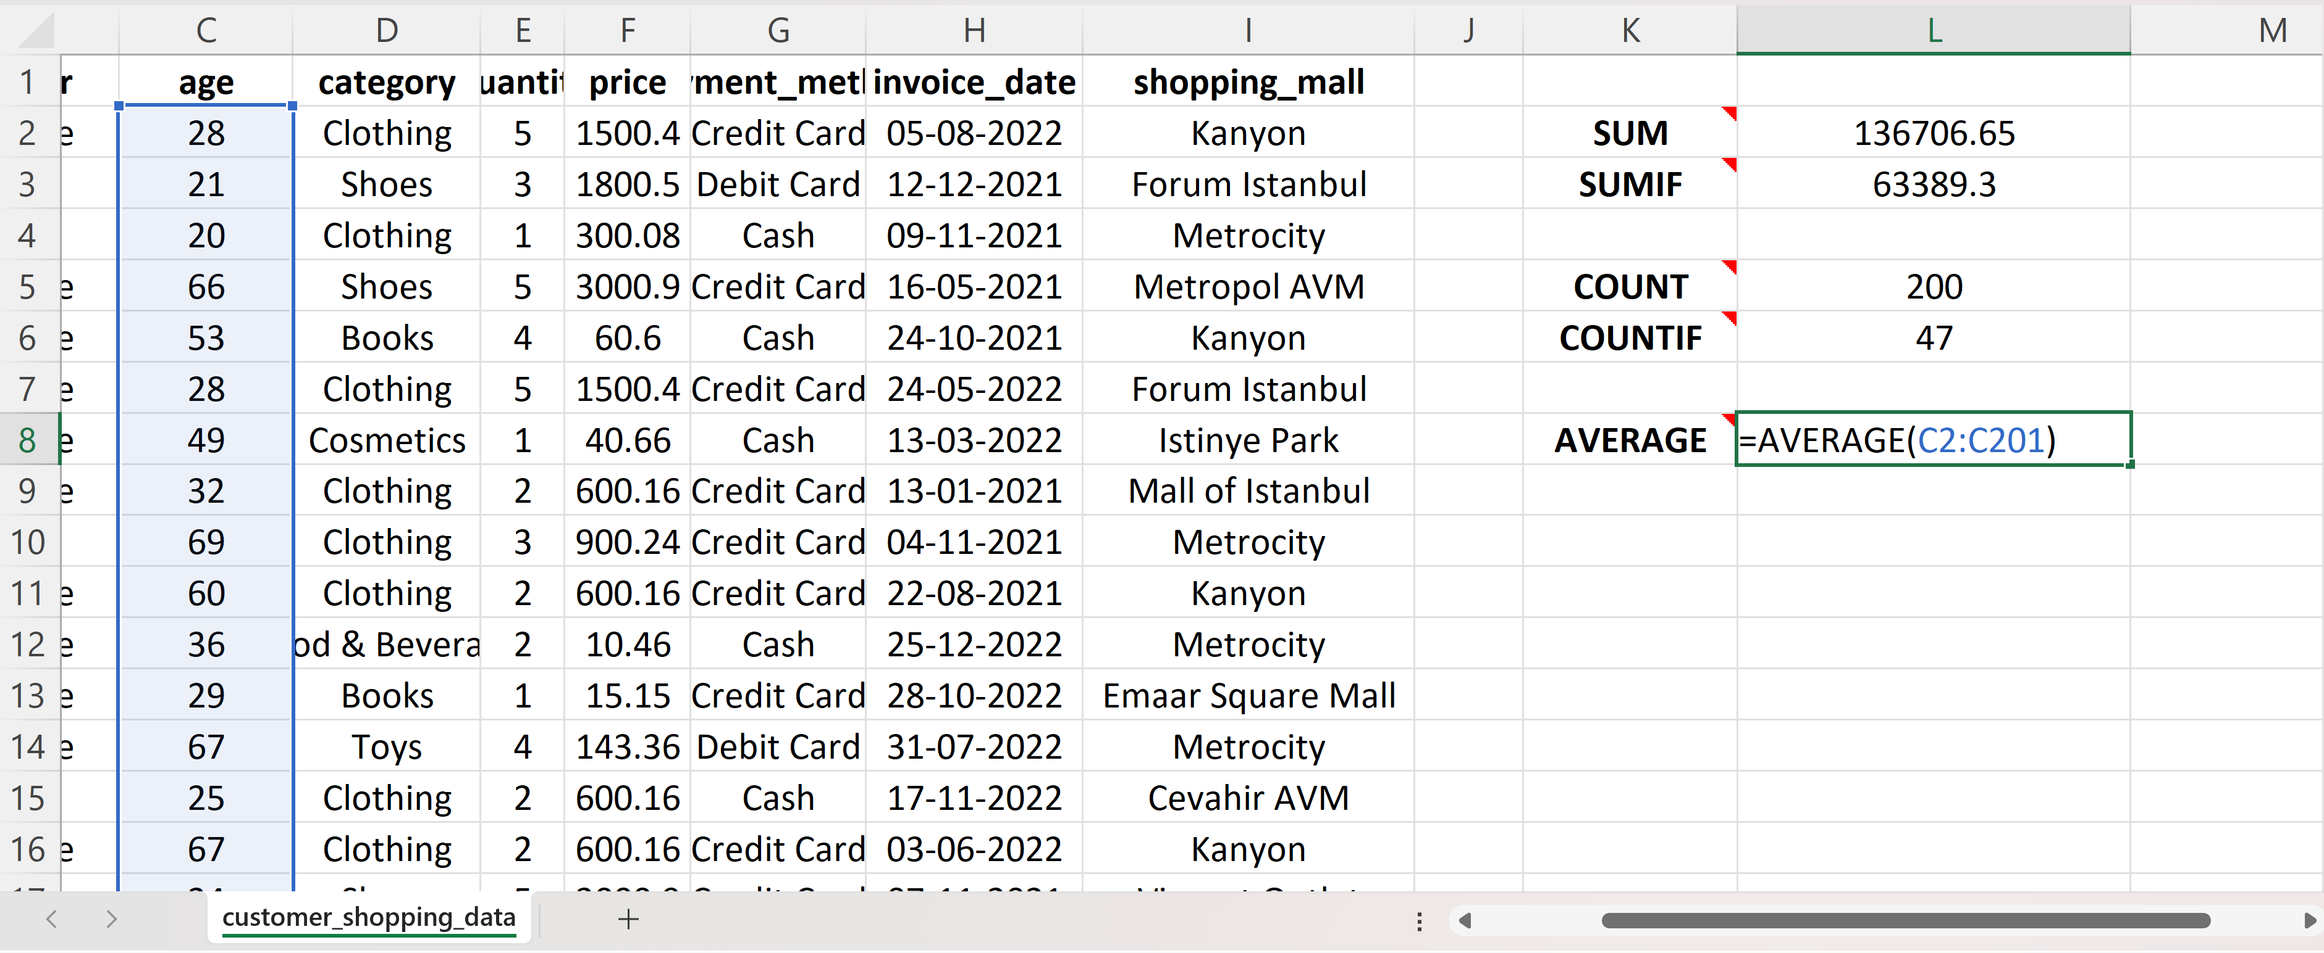
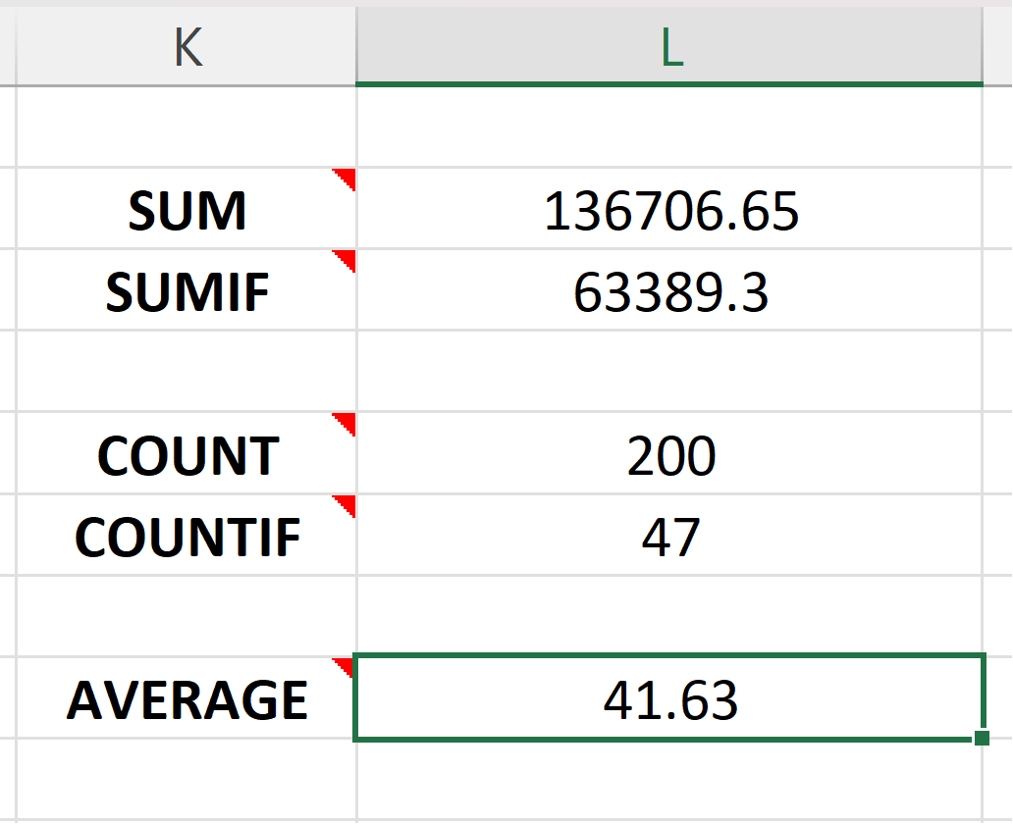
Cont…
AVERAGE Function
Purpose: Calculates the average of a range of numbers.
Usage: =AVERAGE(range)
Example: =AVERAGE(A1:A5) calculates the average of values in A1 to A5.

Slide 30
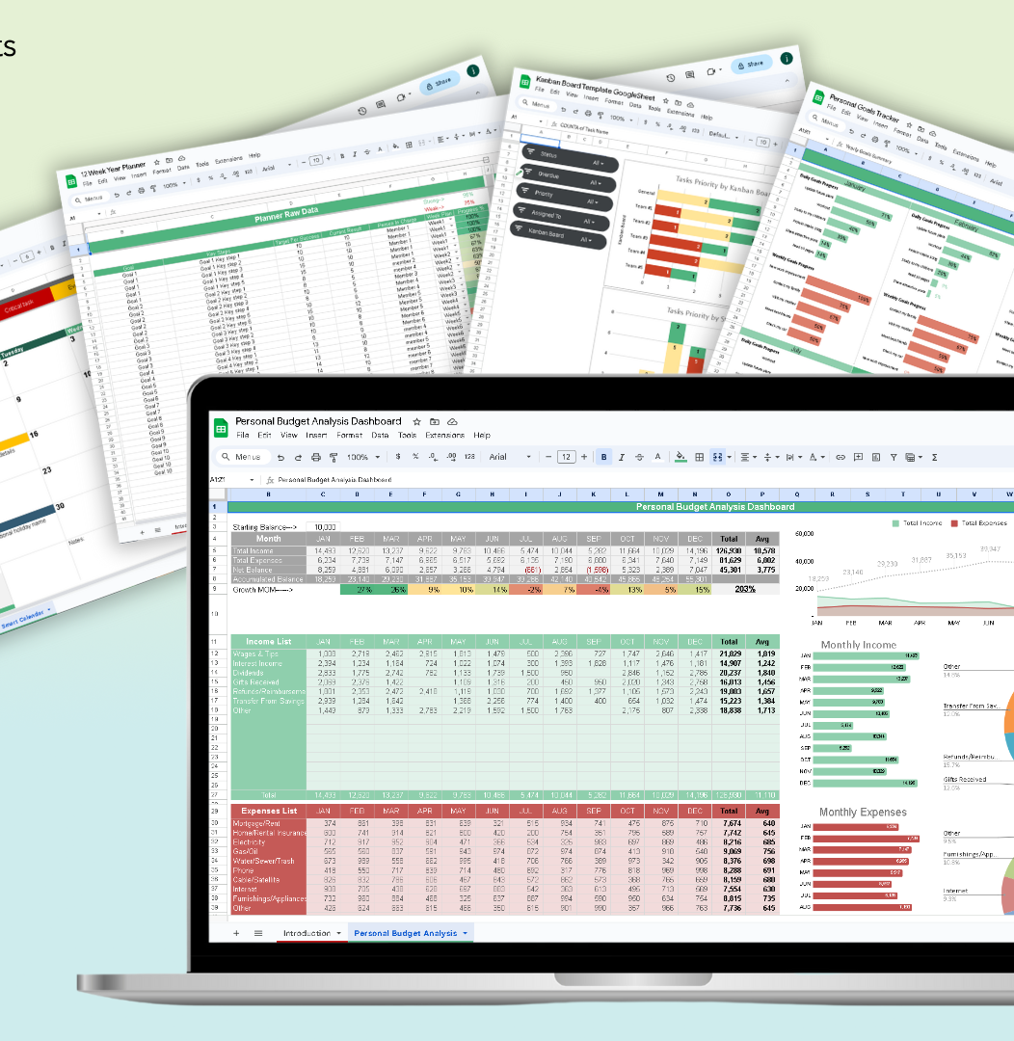
Text Functions and Dates

Slide 31
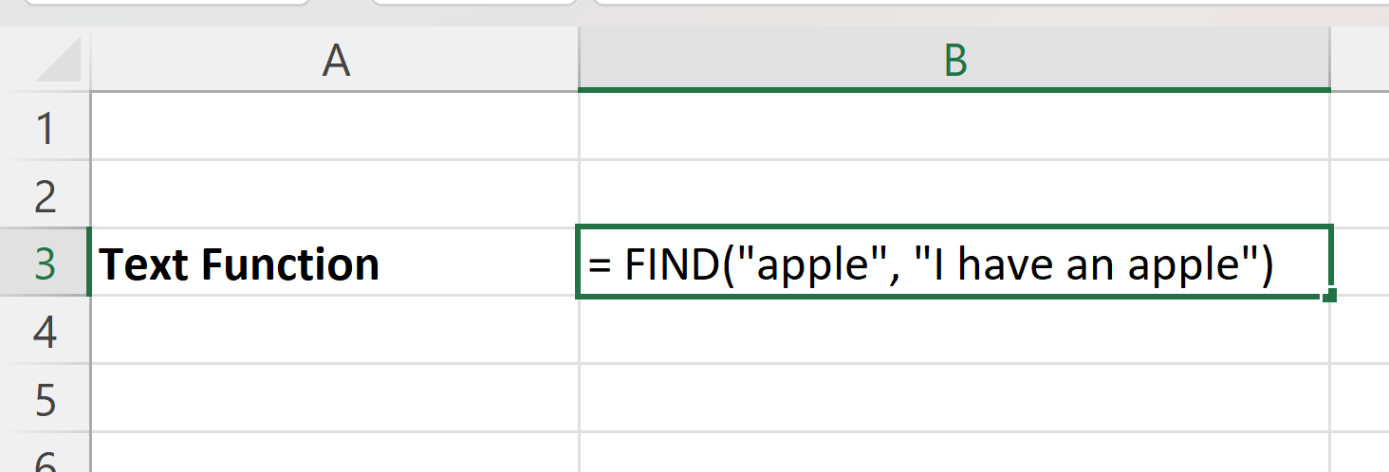
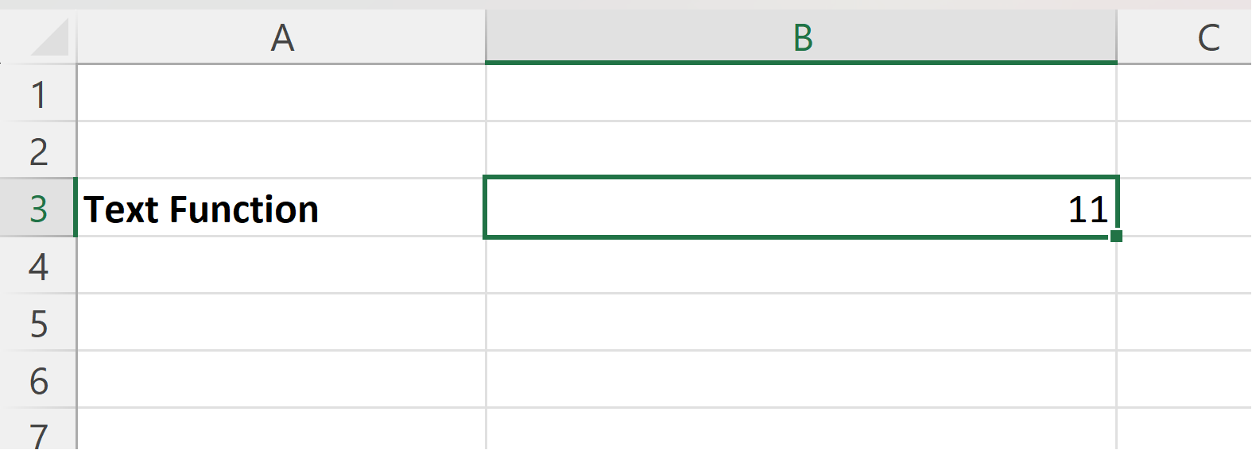
Text Functions
FIND Function
Purpose: Finds the position of a substring within a text string.
Usage: = FIND(find_text, within_text, [start_num])
Example: = FIND("apple", "I have an apple") returns 13 because it finds "apple" starting at the 13th character in the text.

Slide 32
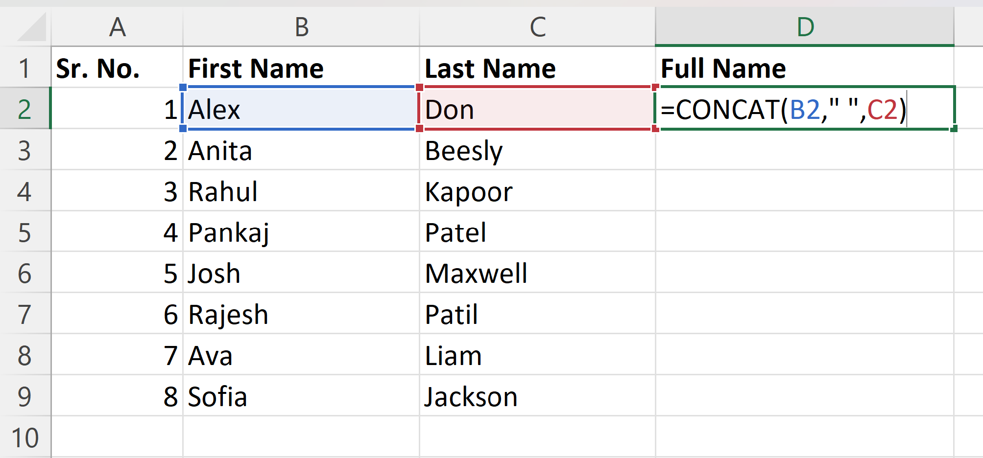
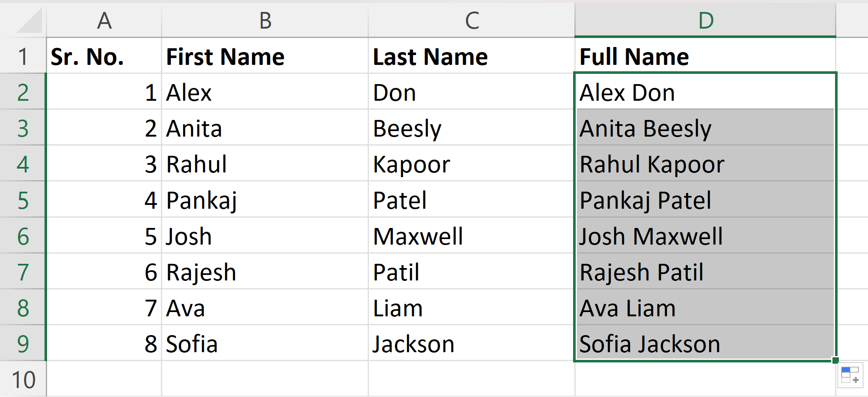

Cont.
CONCATENATE Function (or & Operator)
Purpose: Combines multiple text strings into one.
Usage: =CONCATENATE(text1, text2, ...), or you can simply use the & operator to combine text.

Slide 33


Cont..
LEN Function
Purpose: Counts the number of characters in a text string.
Usage: =LEN(text)
Example: =LEN(“Hello, world!”) returns 13 because the text contains 13 characters.

Slide 34
Excel Formatting
Why format and style your spreadsheet?
Make it easier to read and understand
Make it more delicate
The most used styling functions are
Colors
Fonts
Borders
Number formats
Grids
There are two ways to access the styling commands in Excel
The Ribbon
Formatting menu, by right clicking cells

Slide 35

Cont…
Styling Commands in Ribbon

Slide 36


Cont..
Styling Commands, Right Clicking Cells
Format Painter

Slide 37



Cont..
How to use Print Format
Select the cell which properties you want.
Click on format printer icon
Click on the cell to which properties to apply

Slide 38


Cont..
Excel Number Formats
Right Click on cell
Click on Format Cell

Slide 39



Cont..
Excel Number Formats
Select Currency
4. Click "Ok"

Slide 40
Dates and Times in Excel
Excel handles dates and times as serial numbers, where dates are stored as the number of days since January 1, 1900 (on Windows systems).
Times are stored as decimal values representing fractions of a 24-hour day.
DAYS Function
Purpose: Calculates the number of days between two dates.
Usage: =DAYS(end_date, start_date)
Example: =DAYS(A2, A1) calculates the number of days between the dates in cells A1 and A2.

Slide 41
Cont…
Example Dataset with a Demonstration
Let's say you have an Excel dataset where you want to calculate the number of days between two dates.
In cell C2, enter the formula =DAYS(B2, A2). This calculates the number of days between the end date (B2) and the start date (A2). In this example, it's 10 days.
Copy the formula down to apply it to the entire dataset. In cell C3, it will calculate the number of days between the dates in A3 and B3, which is 5 days.
Start Date | End Date
2023-10-10 | 2023-10-20
2023-11-05 | 2023-11-10

Slide 42



Cont…

Slide 43

Lookup and Conditional Functions

Slide 44
Lookup Functions
VLOOKUP and HLOOKUP are Excel functions used to retrieve specific data from a table
VLOOKUP searches for a value in the leftmost column of a table and returns a value in the same row from a specified column
1
HLOOKUP works similarly to VLOOKUP but searches in the top row of a table and returns a value from a specified row.
2

Slide 45
Cont…
How to Use VLOOKUP and HLOOKUP
VLOOKUP Function
Usage: =VLOOKUP(lookup_value, table_array, col_index_num, [range_lookup])
lookup_value is the value you want to find.
table_array is the range containing the data you want to search.
col_index_num is the column number from which to return data.
[range_lookup] is optional and can be set to FALSE for an exact match or TRUE for an approximate match (usually set to FALSE for most cases).

Slide 46


Cont…
VLOOKUP Function

Slide 47
Cont…
HLOOKUP Function
Usage: = HLOOKUP(lookup_value, table_array, row_index_num, [range_lookup])
lookup_value is the value you want to find.
table_array is the range containing the data you want to search.
row_index_num is the row number from which to return data.
[range_lookup] works the same way as in VLOOKUP.

Slide 48


Cont…
HLOOKUP Function

Slide 49
Conditional Functions
IF Function
Purpose: Allows you to apply conditional logic in Excel.
Usage: =IF(logical_test, value_if_true, value_if_false)
logical_test is the condition you want to evaluate.
value_if_true is the result if the condition is true.
value_if_false is the result if the condition is false.

Slide 50


Cont…

Slide 51
Cont..
IFERROR Function
Purpose: Handles errors by returning a specified value when an error occurs.
Usage: =IFERROR(value, value_if_error)
value is the expression or formula you want to evaluate.
value_if_error is the value to return if an error occurs

Slide 52


Cont…

Slide 53
Cont..
Using IF Function for Pass/Fail
In cell C2, enter the formula: =IF(B2 >= 50, "Pass", "Fail"). This checks if the score in cell B2 is greater than or equal to 50 and returns "Pass" or "Fail" accordingly.
Copy this formula down the column to apply it to all students.
Using IFERROR Function for Handling Errors
In cell D2, enter the formula: =IFERROR(B2, "N/A"). This checks if there is an error (e.g., a missing score in cell B2) and returns "N/A" if an error occurs.
Copy this formula down the column to handle errors for all students.

Slide 54

Data Cleaning Techniques

Slide 55
Data Cleaning Techniques
Text Functions and Their Role in Cleaning Data
TRIM Function: Removes leading/trailing spaces, improving formatting.
LOWER and UPPER Functions: Standardize text to lowercase or uppercase.
PROPER Function: Capitalize the first letter of each word for consistency.
CONCATENATE Function: Merge text from multiple cells for uniformity.
LEFT and RIGHT Functions: Extract specific text portions for cleaning and analysis.
Suppose you have a dataset of product names, and you want to clean the text data to ensure consistency
Product Name
Apple iPhone 12
Samsung Galaxy S21
hp Laptop
Dell XPS 15 Laptop
Microsoft Surface Pro 7
ASUS ZenBook

Slide 56
Cont…
Here's how you can use text functions for data cleaning
Use the TRIM Function: In a new column, use the formula =TRIM(A2) to remove extra spaces from the product names.
1
Use the PROPER Function: In another new column, use the formula =PROPER(B2) to capitalize the first letter of each word in the cleaned product names
2
Use CONCATENATE Function: If you want to standardize the format further, you can concatenate the cleaned text with additional information. For example, if you want to add " - Electronics" to each product name, use =B2 & " - Electronics".
3

Slide 57

Q&A and Practical Exercises

Slide 58

Practical Exercise: Student Result
Dataset: Student Result
Calculate – Total, Average, Grade, Result
Grade – A++ < 90, A+ < 80, A < 70, B+ < 60, B < 35, else F
Result – If Grade = F -> Fail else Pass

Slide 59


Cont…
To Calculate Total Marks
To Calculate Around Up Average (Average without decimal points)

Slide 60


Cont…
To Calculate Grade

Slide 61


Cont…
To Calculate Result

Slide 62

Data Visualization with Conditional Formatting

Slide 63
Conditional Formatting
Automatically formats cells based on specified conditions.
Visually highlights data, making trends and key information stand out.
How to Use Conditional Formatting to Highlight Specific Data
Select Data: Choose the data range you want to format.
Access Conditional Formatting: Go to “Home” > “Conditional Formatting.”
Choose a Rule: Pick a formatting rule (e.g., “greater than”).
Set Formatting: Define the rule conditions and the style you prefer.
Preview and Apply: Review the formatting, then click “OK” to apply it to the selected cells

Slide 64


Cont…
Let's Apply Yellow Color to Pass & Red to Fail in Result Column
Click on cell K2
Click on Conditional Formatting
Click on Highlight Cells Rule
Click on Equal to
Type "Pass"
Select "Yellow Fill with Dark Yellow Text"
Repeat the same for "Fail" & apply "Red" Color.
"Double Click" to cell apply to all cells
1
2

Slide 65

Cont…

Slide 66


Cont…
Let's Apply color scale as per value to the Average Field.
Click on cell I2
Click on Conditional Formatting
Click on Color Scale --> More Rules..
Select Minimum Color to Red & Maximum Color to Green
Click on “OK”
“Double Click” to cell apply to all cells
1
2

Slide 67

Cont…

Slide 68

Sorting, Filtering, and Subtotals

Slide 69

Sorting and Filtering in Excel
Sorting and filtering are essential data manipulation techniques in Excel.
Sorting arranges data in a specific order, while filtering displays only data that meets certain criteria.
How to Sort Data in Excel
Select a Range: Choose the range of data you want to sort.
Access the Sort Tool: In the “Data” tab, click on “Sort.”
Choose a Column: Select the column by which you want to sort your data.
Sort Order: Specify if you want to sort in ascending (A to Z or 1 to 9) or descending (Z to A or 9 to 1) order.
Apply Sorting: Click “OK” to apply the sorting

Slide 70

Cont…
Let's Sort the dataset by “age”
Select the table
Click on “Data” tab in Ribbon
Click on “Sort”
Click on “Expand the Selection”
Select Column to Sort as “age”
Sort on as “Cell Values”
Order as “Smallest to Largest”
Click on “OK”

Slide 71



Cont…

Slide 72

Cont…
How to Apply Filters in Excel
Select a Range: Choose the data range you want to filter.
Access the Filter Tool: In the "Data" tab, click on "Filter."
Filter Criteria: Use the drop-down arrows in the column headers to set criteria for filtering. You can filter by specific values, conditions, or custom criteria.
Apply Filters: Click "OK" to apply the filters and display only the data that meets your criteria.

Slide 73


Cont…
Filtering the Columns
Select the Top row (column names)
In Home Tab, click on “Sort & Filter”
Click on “Filter”
A drop-down button will be added to the column names.
For Example – Click on Drop-down at “Gender Col”
Unselect Male & click “OK"
This will show only Female Customers

Slide 74

Working with Ranges and Tables

Slide 75
Subtotals with Ranges
Subtotal functions perform calculations on specific data ranges.
They are used to create subtotals within larger datasets, based on defined groups
Steps to Create Subtotals
Prepare Data: Organize data with a column defining groups.
Select Data: Highlight the dataset, including the group column.
Access Subtotal Tool: Go to "Data" > "Subtotal."
Configure Options: Define the grouping column, the calculation type (e.g., sum), and the columns to subtotal.
Apply Subtotals: Click "OK" to generate subtotals within the range.

Slide 76
Cont…
Dataset with Subtotals
Suppose you have a sales dataset with regions and sales figures
Select the entire dataset.
Access the "Subtotal" tool.
Configure options: Set "At each change in" to the "Region" column, use the "Sum" function, and add subtotals to the "Sales" column.
Click "OK" to apply the subtotals
Region | North | South | North | West | South
Sales | 500 | 750 | 600 | 450 | 800

Slide 77
Working with Ranges and Tables
In Excel, defining ranges and creating tables are techniques to structure and manage data effectively
How Tables Can Improve Data Management
Tables offer several advantages
Easy data organization with headers.
Auto-expansion for new data.
Built-in filtering and sorting options.
Improved data integrity and error reduction.

Slide 78
Cont….
Demonstration of Defining a Table
Select Data: Highlight the data range you want to convert into a table.
Create a Table: In the “Insert” tab, click on “Table.”
Define the Table: Ensure the “Create Table” dialog recognizes your data range. Check the box if your table has headers.
Confirm: Click "OK" to create the table

Slide 79
DoubtBusters: Go-To Place for Clearing Doubts​
Every Thursday, we conduct DoubtBusters, where we address your academic doubts and queries.
Ways to Submit Doubts/Queries:​
Through Your LMS Profile: You can find the Doubt Submission FORM link under the “My Account” section of your LMS account.
Via Email Link: Every Monday, you receive an email having Doubt Submission FORM link.

Slide 80
Thank You

